Slide 1
Destination Dingle
&
Southwest Ireland

Slide 2
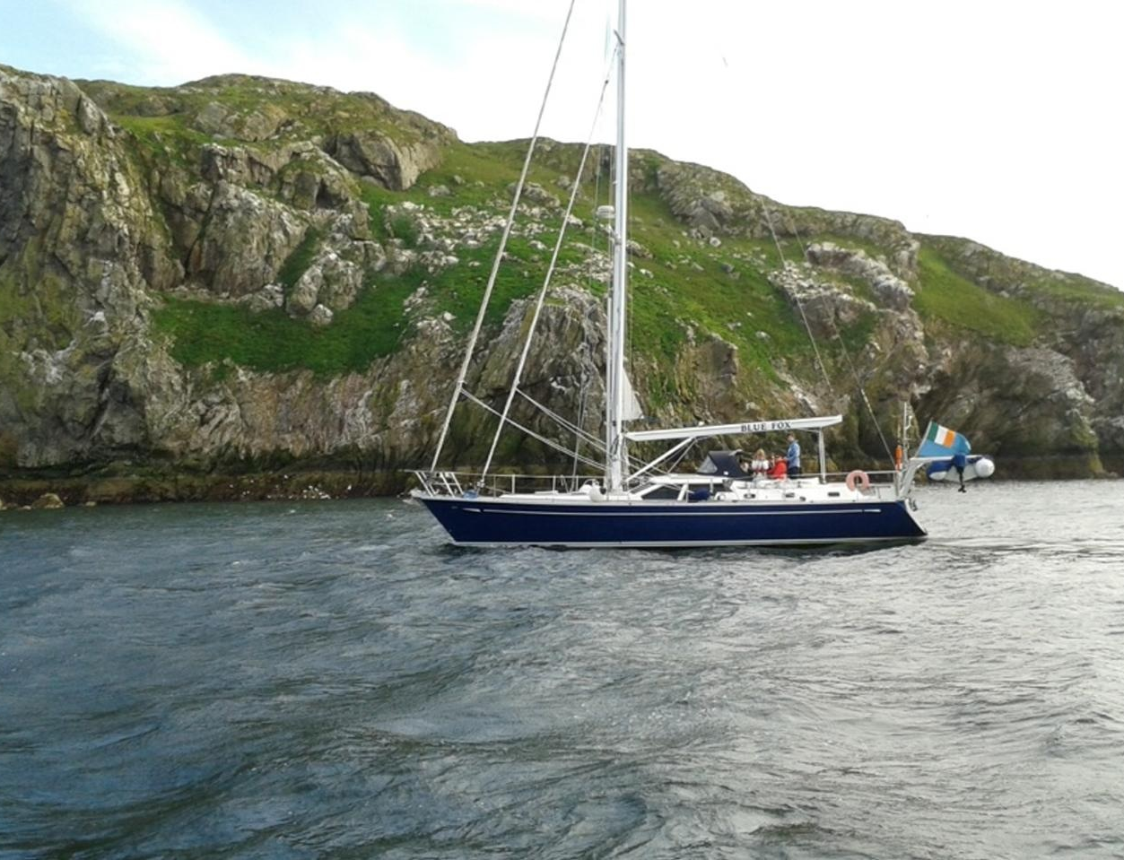
Why Ireland……
Not overcrowded
Semi offshore
Good Navigation
Tidal gates
Brexit
Ground Transportation

Slide 3
Preparation:
Boat
Safety checks
Safety gear
Medical
Victualling
Weather

Slide 4
Underway / Making way…
Crew
Route planning
Watch system
Weather
Log keeping
Expect the unexpected

Slide 5
Route Overview

Slide 6
Legs……
Howth – Dingle 280Nm
Dingle – Valentia Isl 16Nm
Valentia – Bere Island 49Nm
Bere Island – Glengarriff 15Nm
Glengarriff – Bantry Harbour 8Nm
Bantry Harbour – Crookhaven 37Nm
Crookhaven – Kinsale 56Nm
Kinsale – Dunmore East 61Nm
Dunmore East – Greystones 80Nm
Greystones – Howth 16Nm

Slide 7
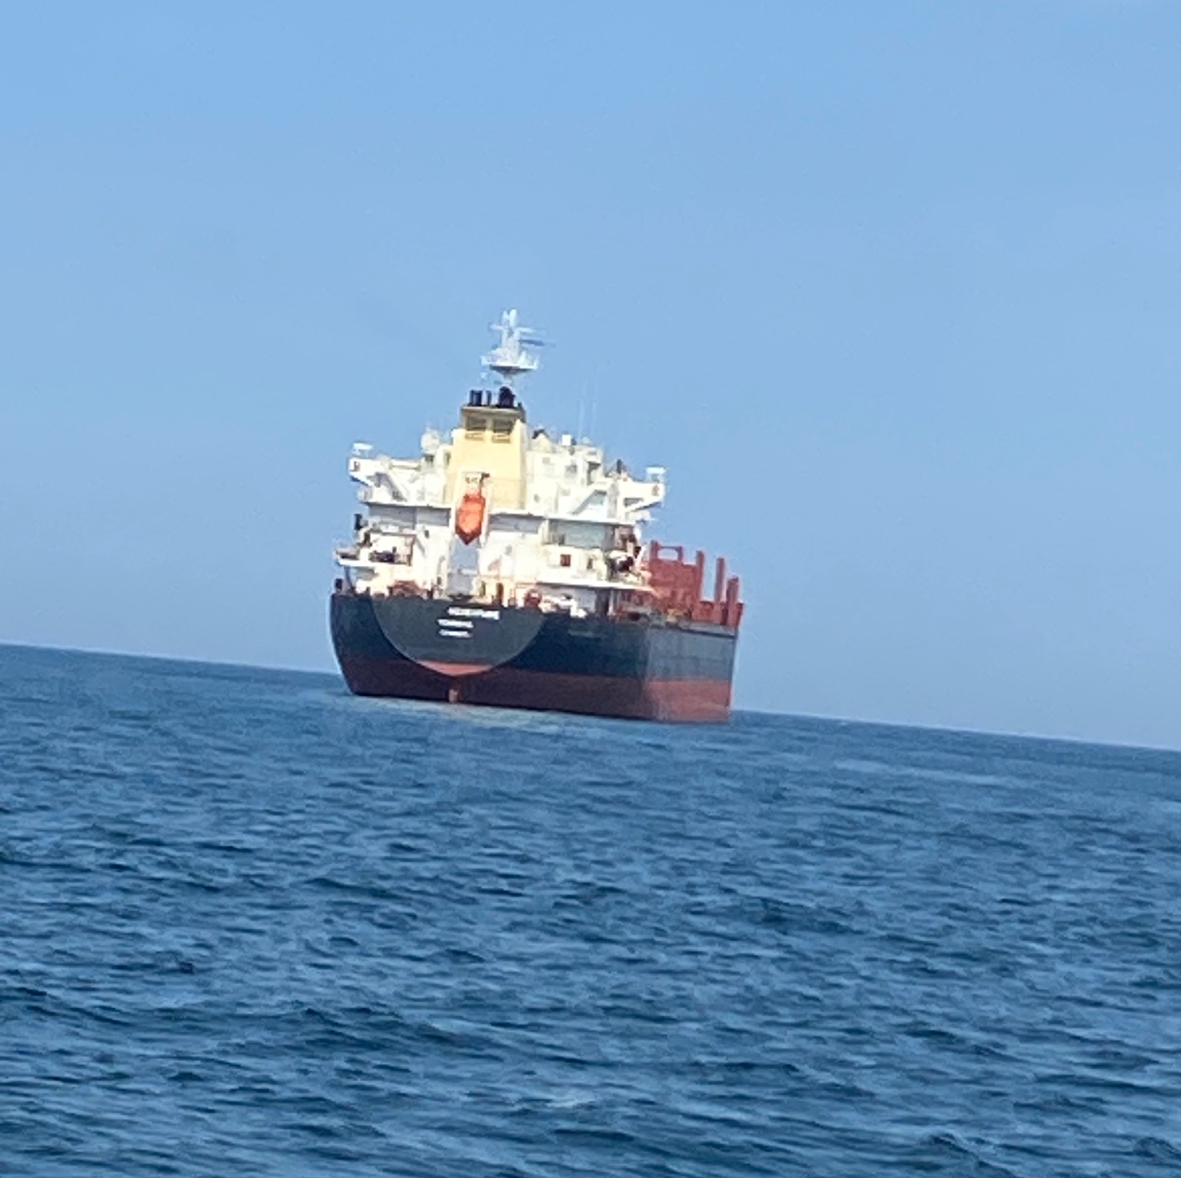
Howth - Dingle

Slide 8
ARKLOW BANK WIND TURBINES IN THE MIST….

Slide 9
THE VICE-COMMODORE REFLECTS.…

Slide 12
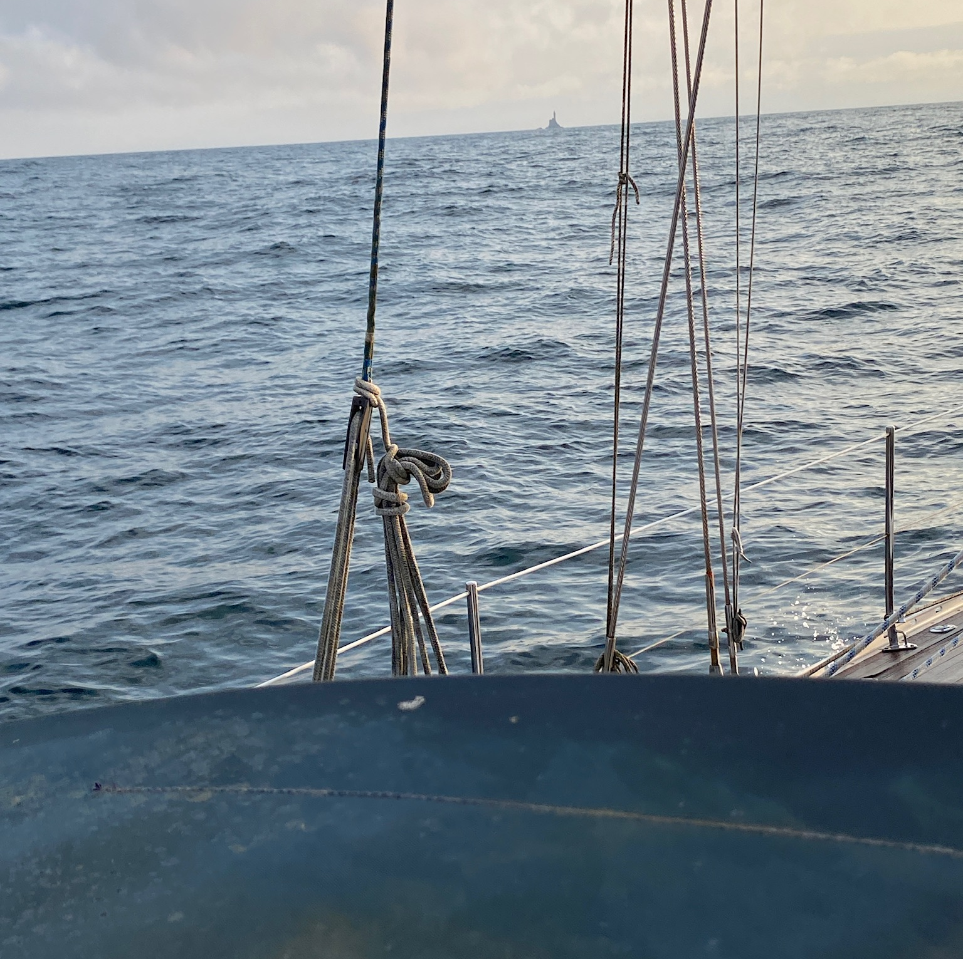
Outside Fastnet

Slide 13
Dingle Bay

Slide 14
PAYING HOMAGE TO TOM CREAN

Slide 15
Valentia Island

Slide 19
Valentia – Bere Island - Bantry Bay

Slide 20
THAT’S BLUE FOX OUT THERE!

Slide 21
SKELLIGS but no time to stop

Slide 22
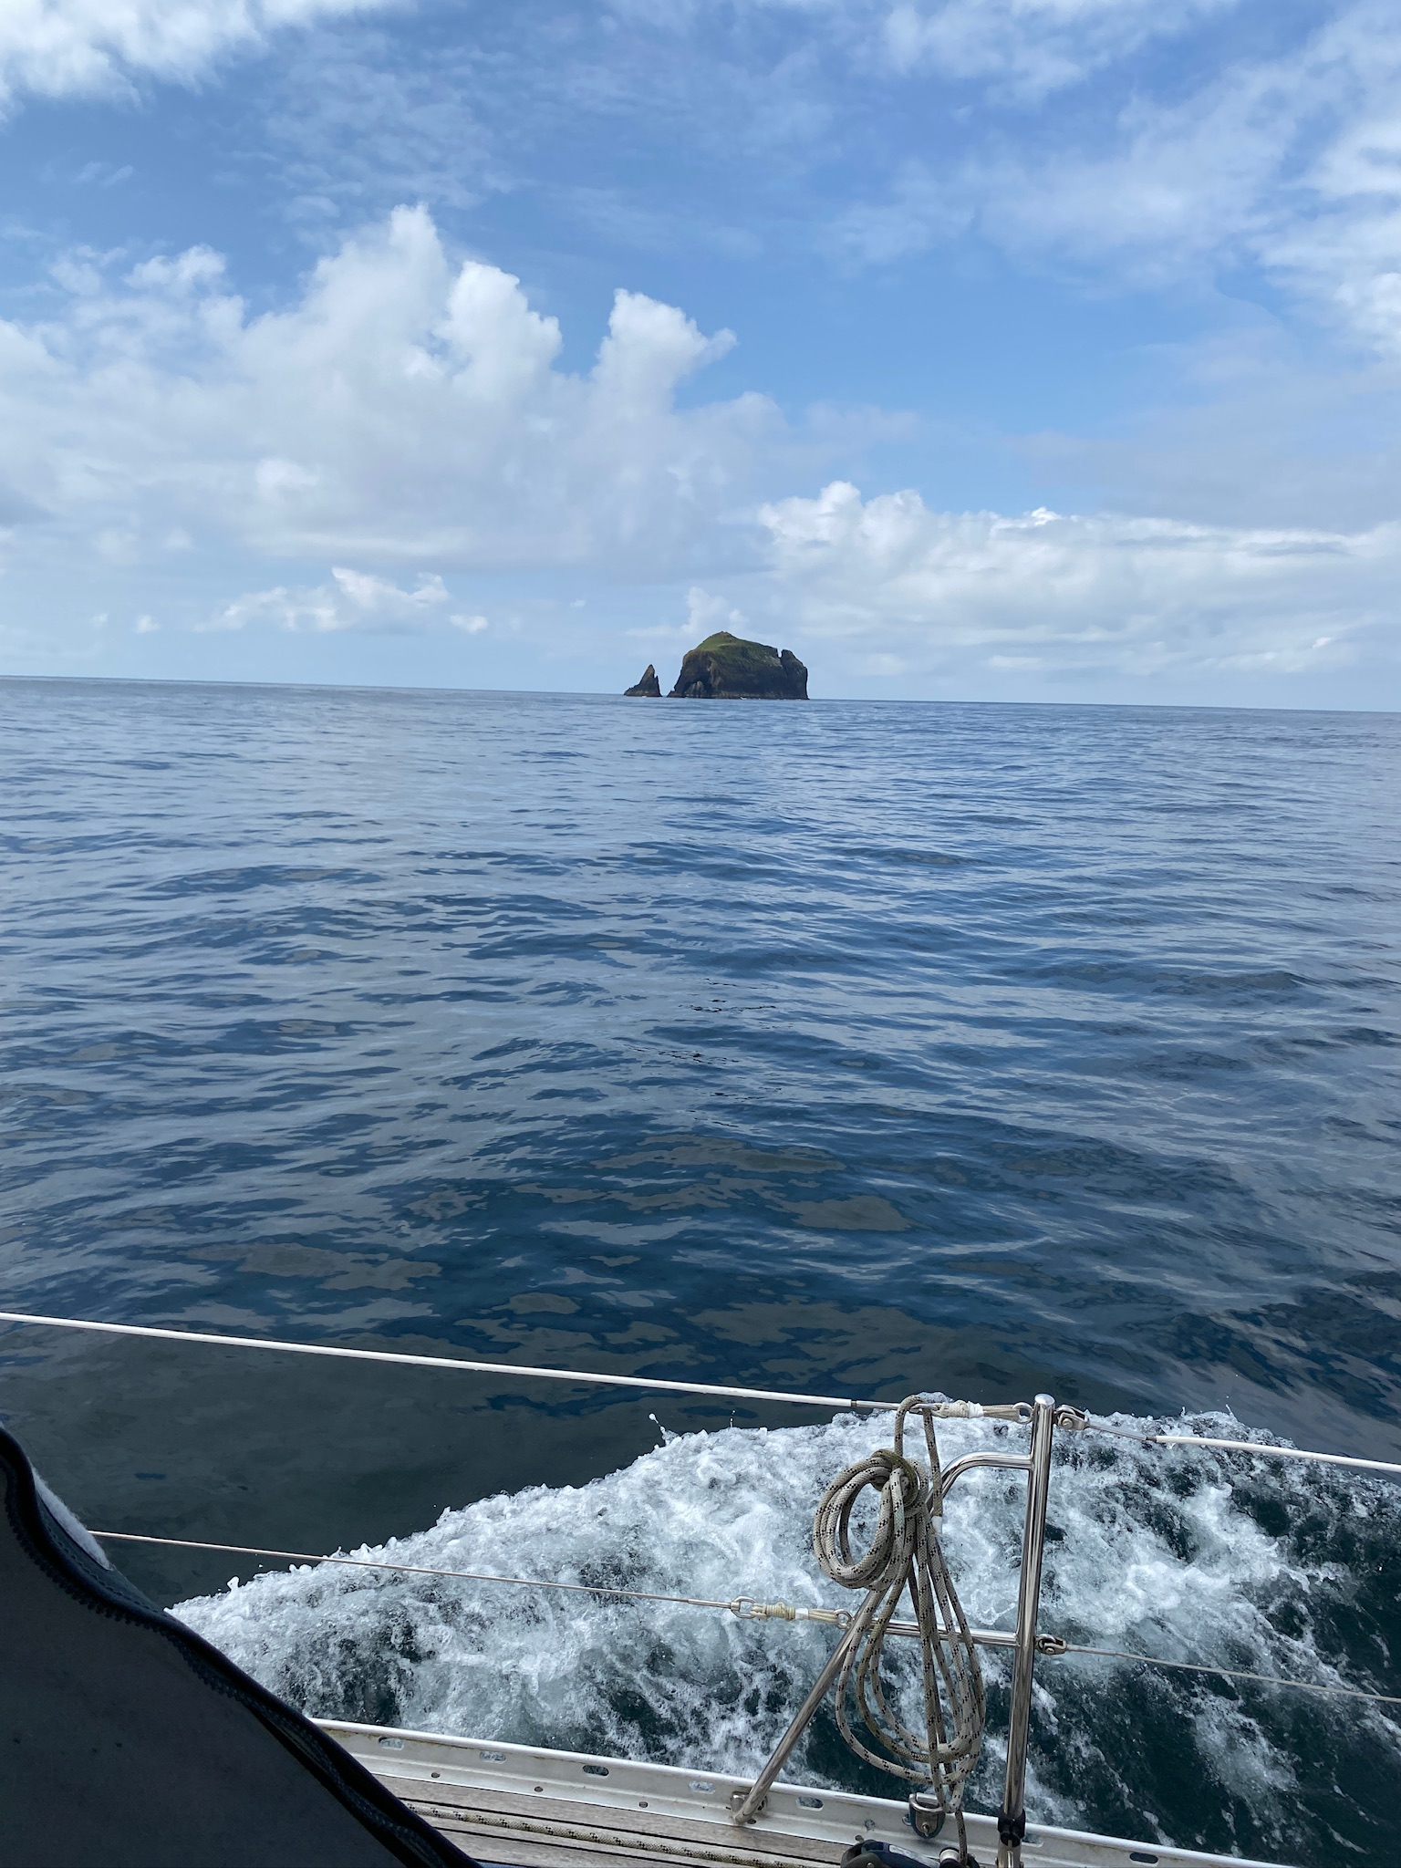
BULL & CALF

Slide 23
LAWRENCE COVE – HEAVEN!

Slide 25
OPEN EVEN IF THE DOOR IS CLOSED…..

Slide 29
A USEFUL APP TO HAVE

Slide 31
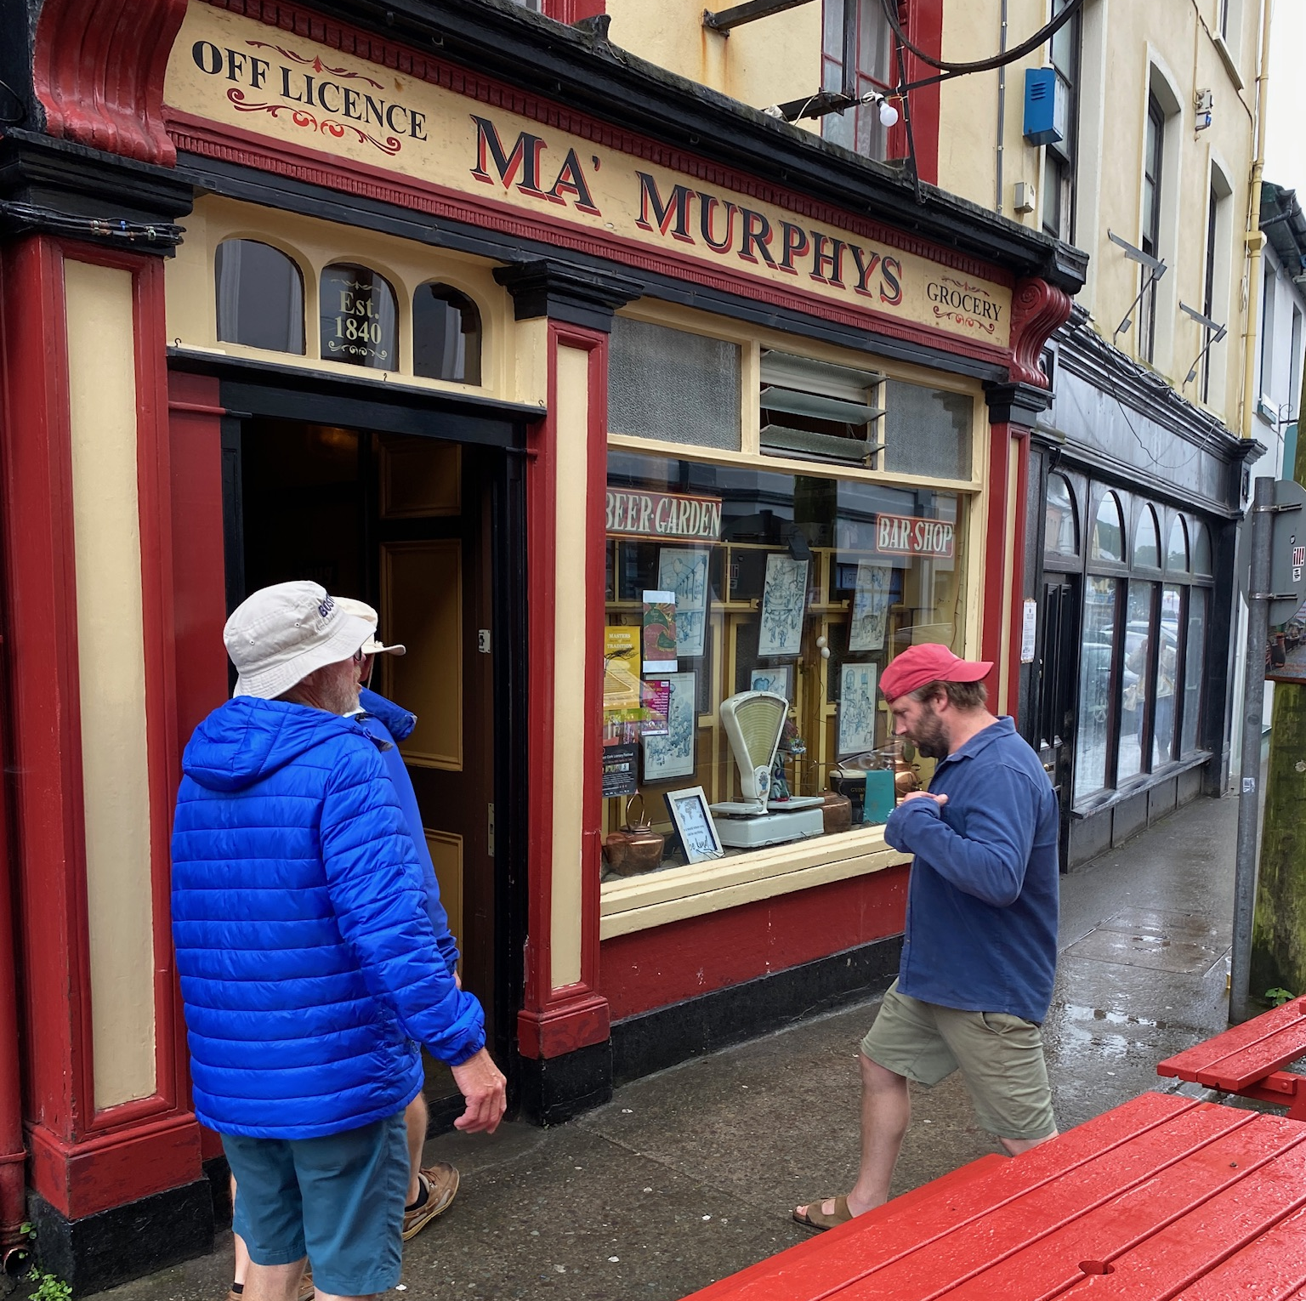
WHEN IT’S RAINING…

Slide 32
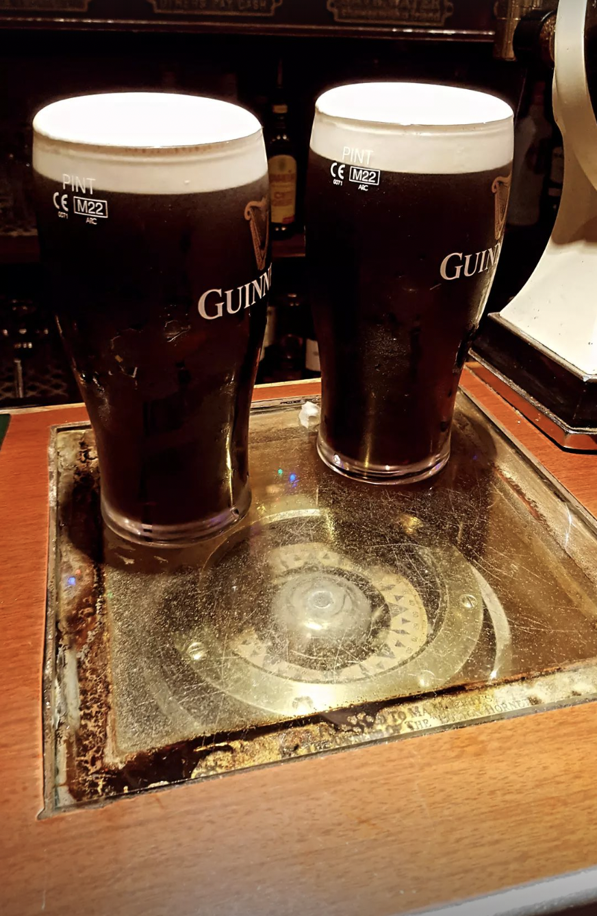
….practice navigation!

Slide 33
Bantry – Crookhaven - Kinsale

Slide 34
PLANNING THE TRIP TO CROOKHAVEN

Slide 36
CROOKHAVEN

Slide 38
PETER C MAKES READY

Slide 39
CREW BREAKFAST!

Slide 40
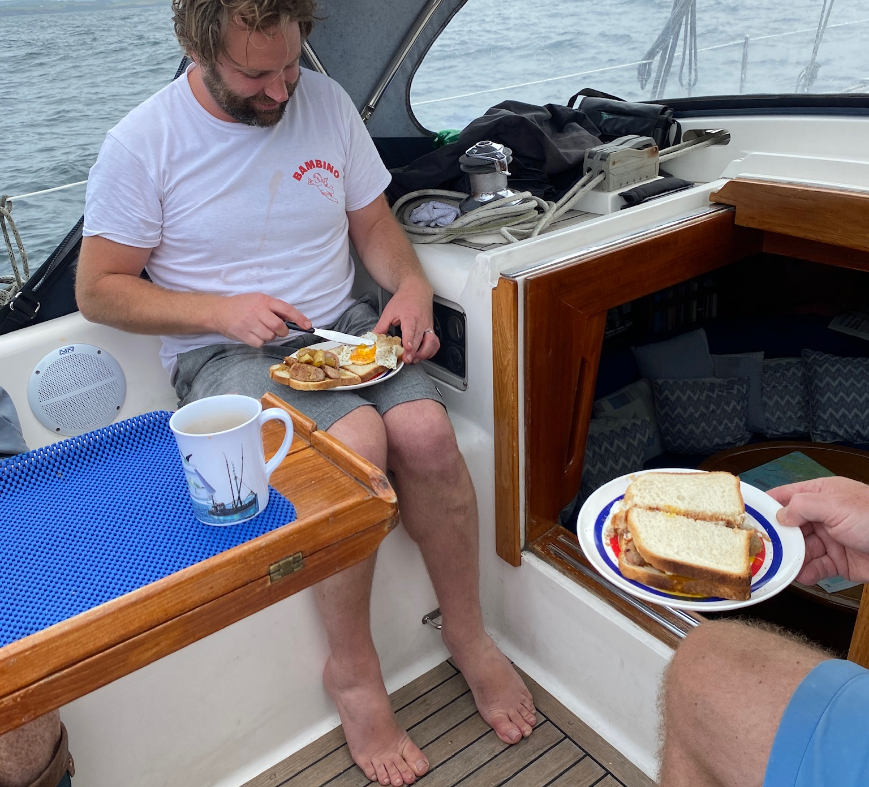
FUEL FOR SAILORS

Slide 42
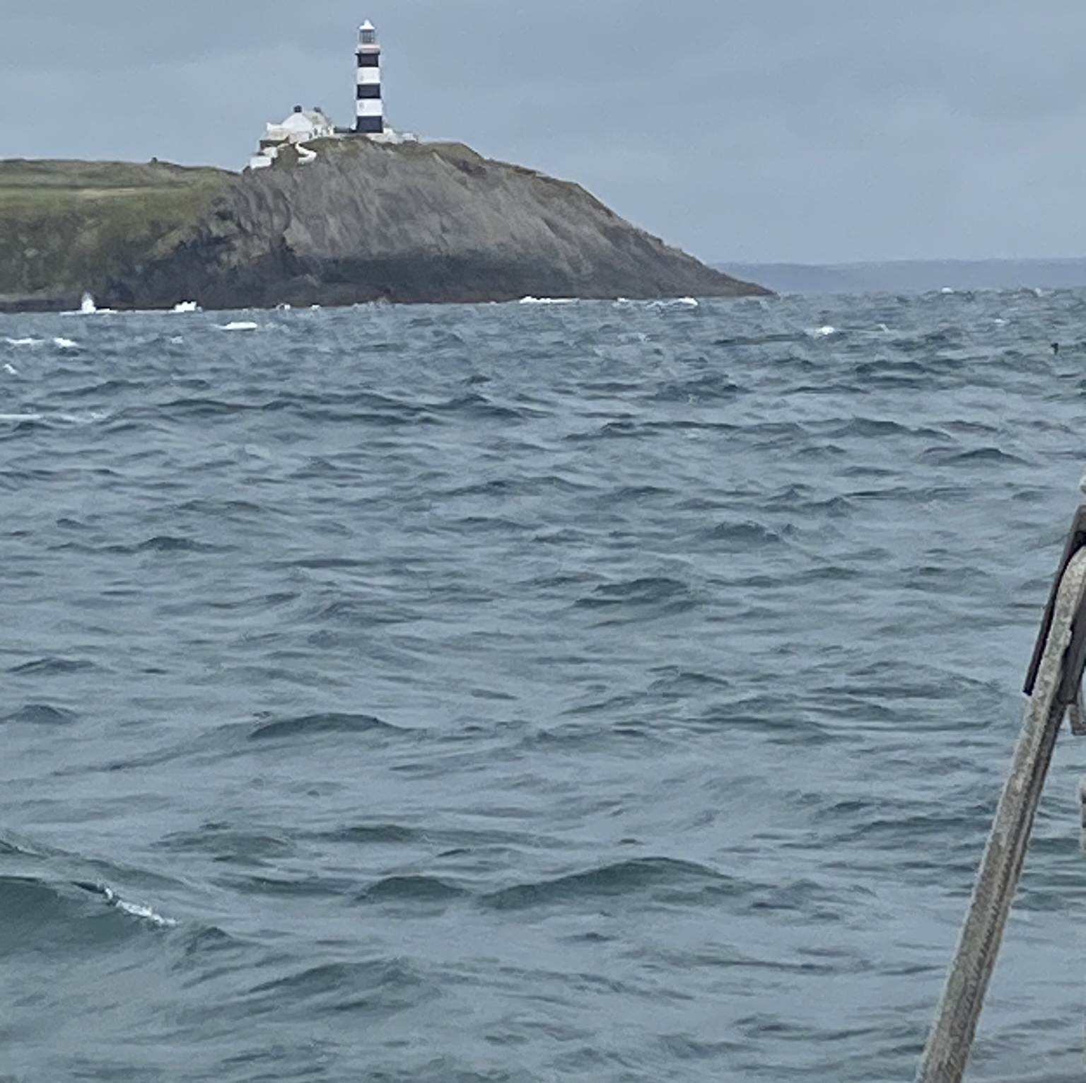
Old Head

Slide 43
Kinsale – Dunmore East – Greystones - Howth

Slide 45
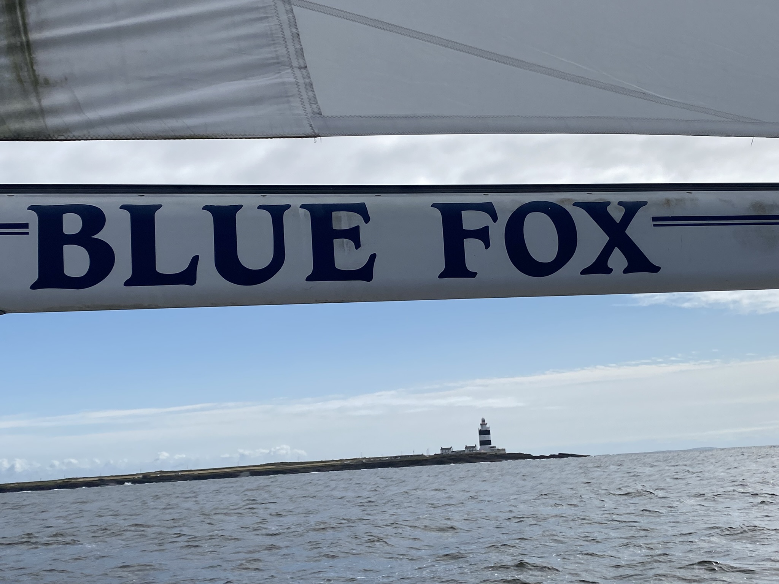
HOOK HEAD

Slide 46
WICKLOW HEAD

Slide 47
GREYSTONES FOR THE NIGHT

Slide 48
Expect the unexpected……
Lobster pots!!!

Slide 49
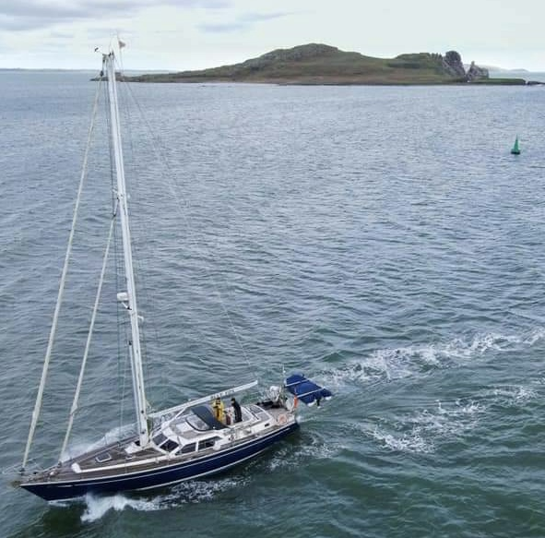

Slide 50
Thank you

