Slide 1
Flotilla Report: Southern Ionian, Greece May 2024
Mags Ward

Slide 2
Flotilla: what’s it all about?
Concerns: am I mad?
Preparation: What the heck do I need to do? My crew?
Expectations: death & destruction
Reality: a dream realised with lots of help & prep

Slide 3
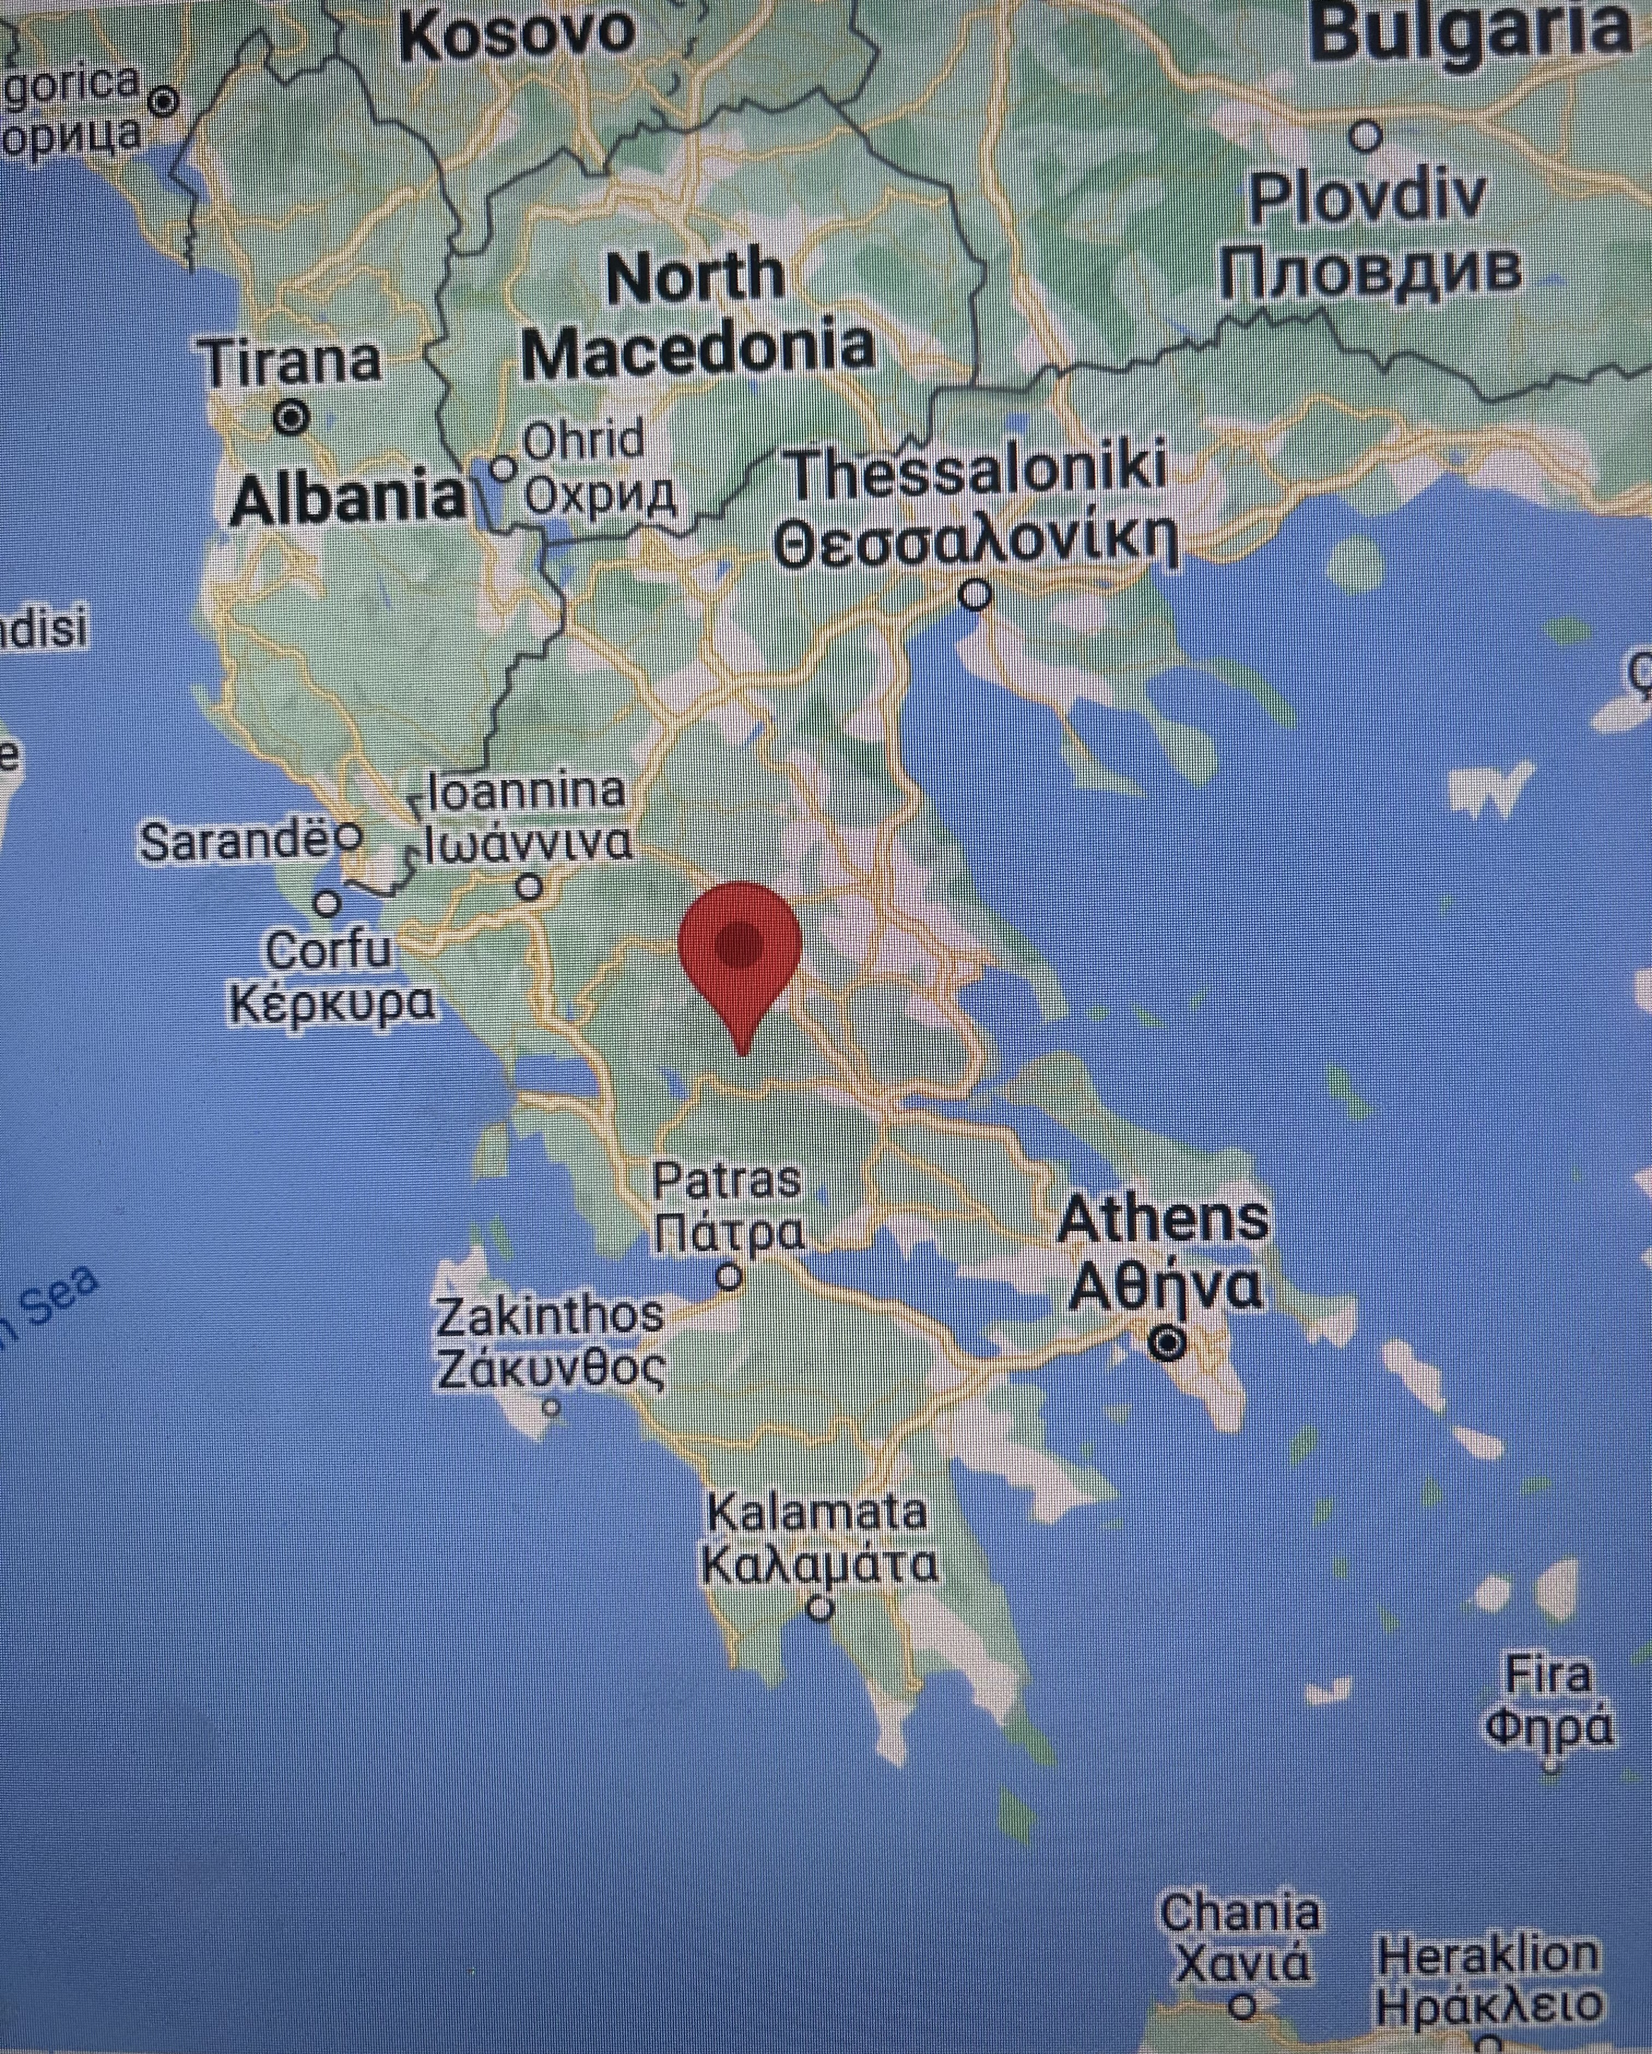

Slide 4
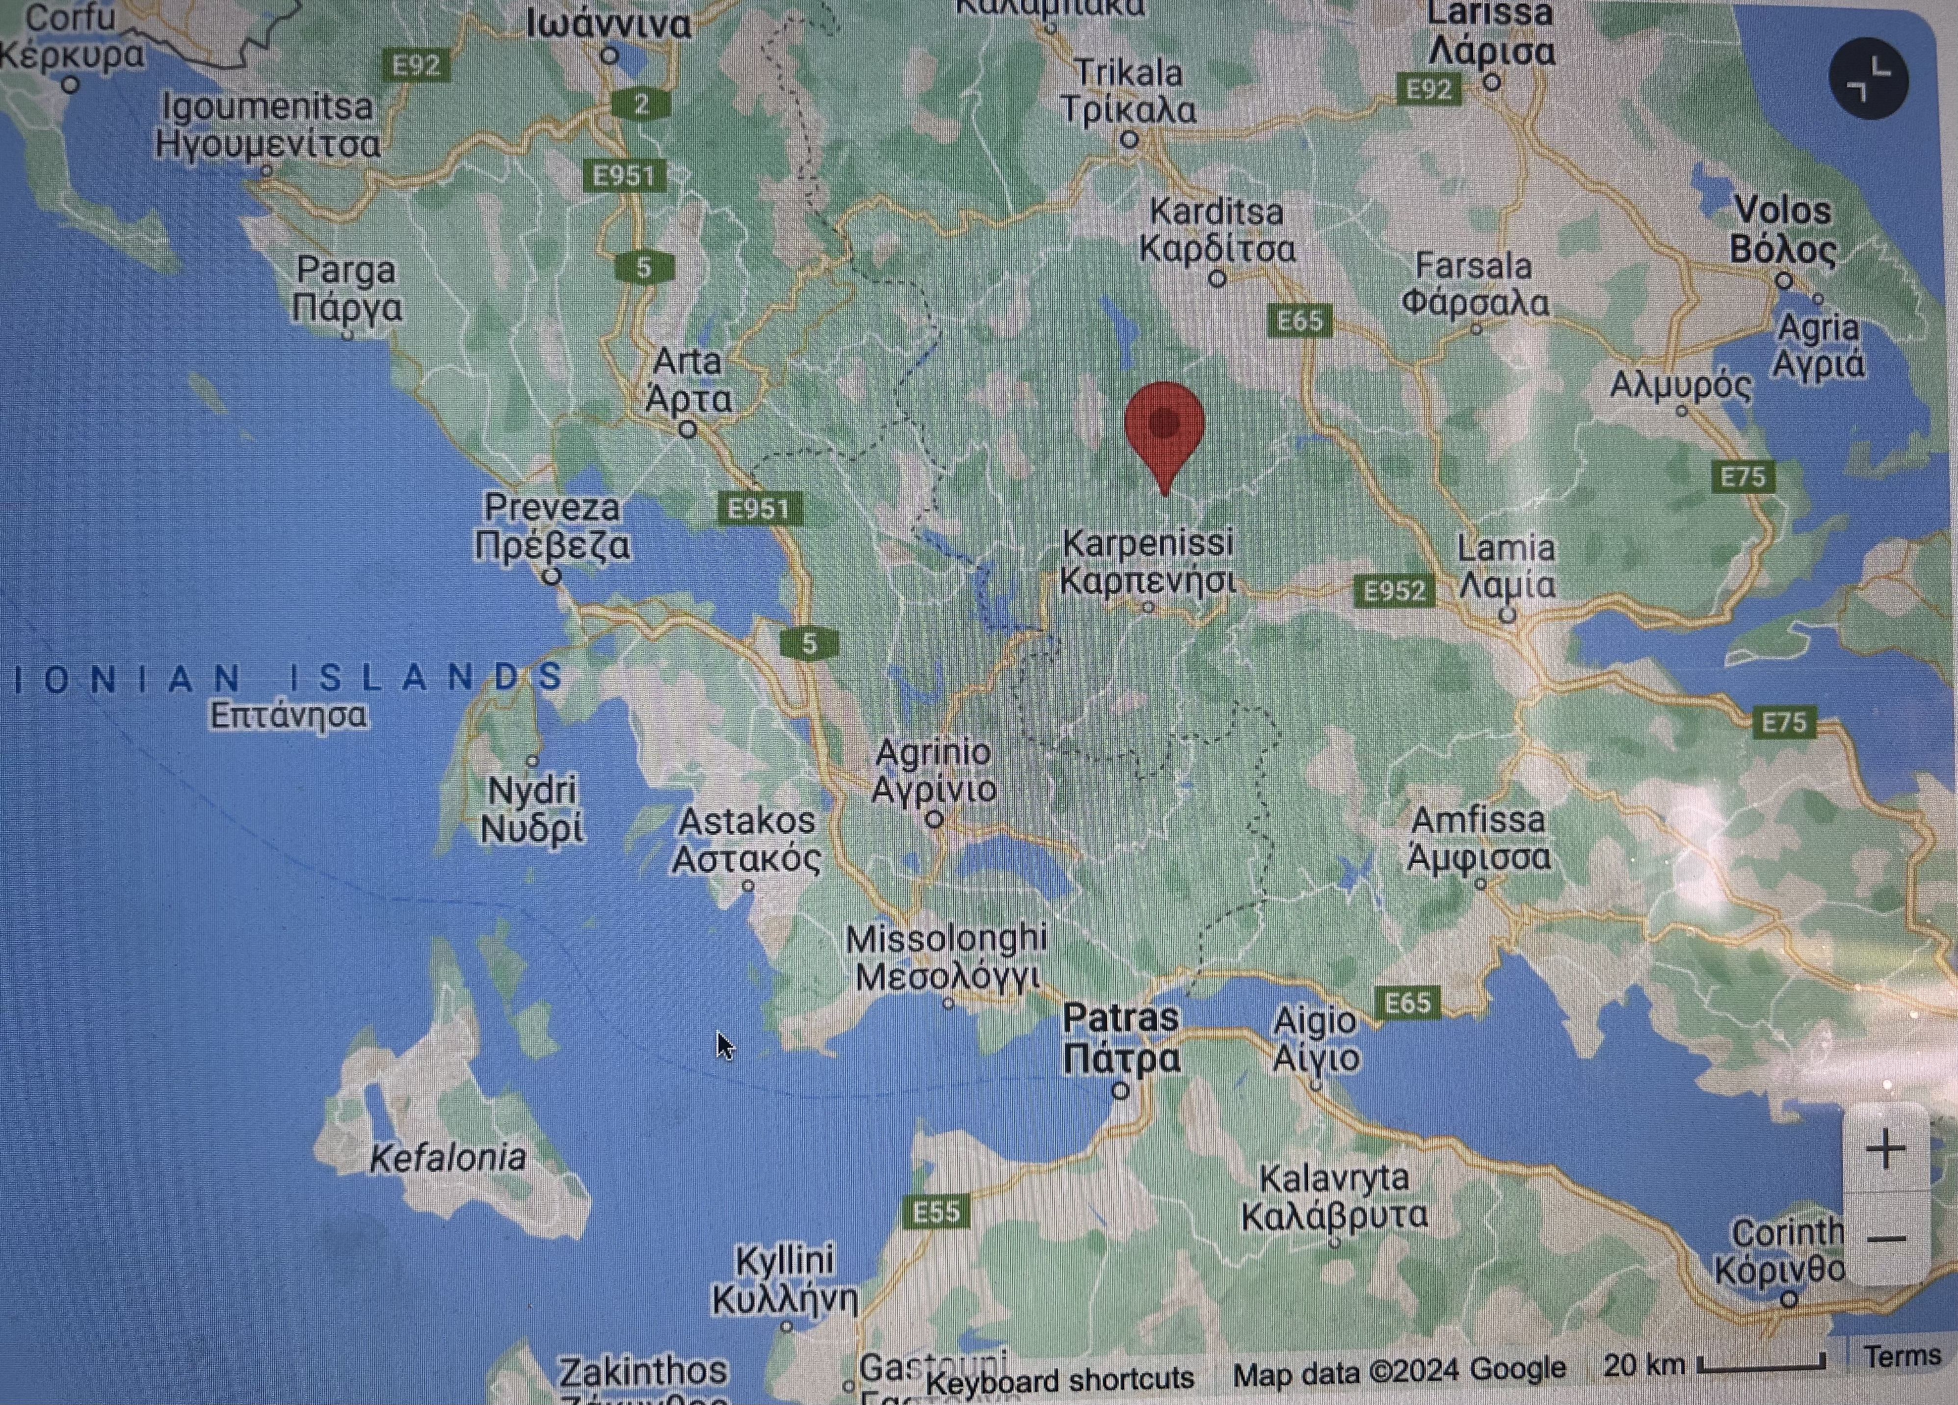

Slide 5
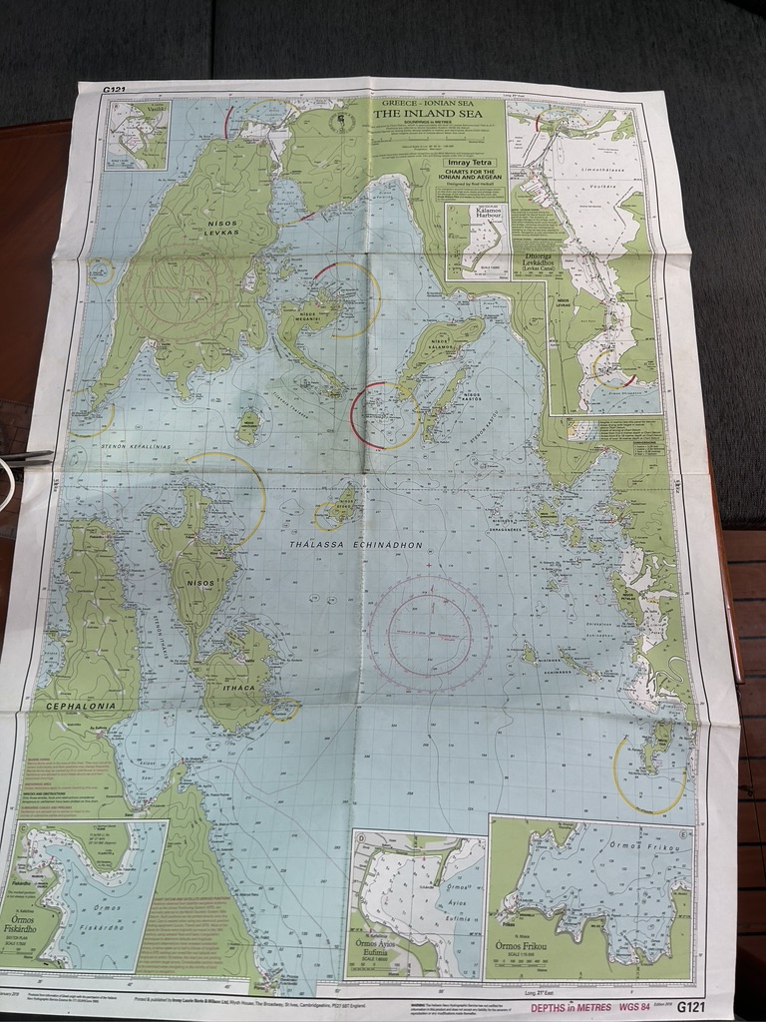

Slide 6
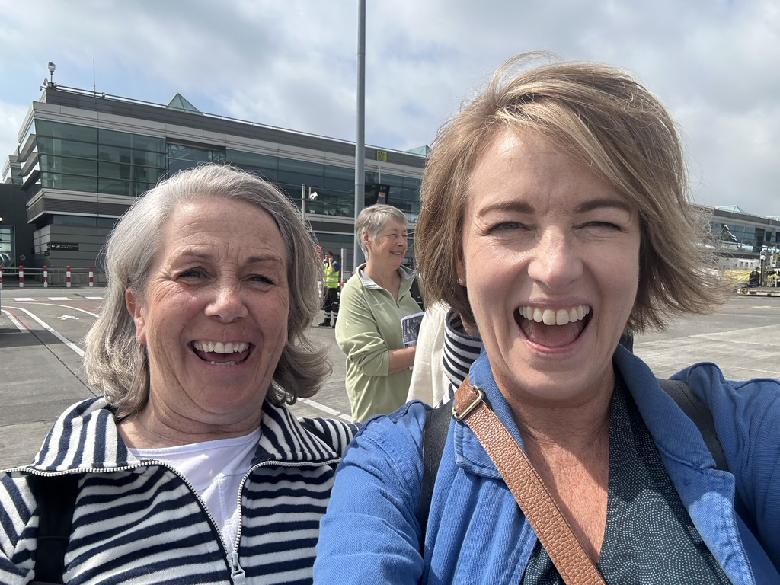
Blame where it’s due….

Slide 7
Southern Ionian Ports (one week)
Sivota, Lefkas
Spartahori, Meganisi
Kastos, Kastos
Big Vathi, Ithaka
Effimia, Kefalonia
Fiskardo, Kefalonia
Sivota, Lefkas

Slide 8
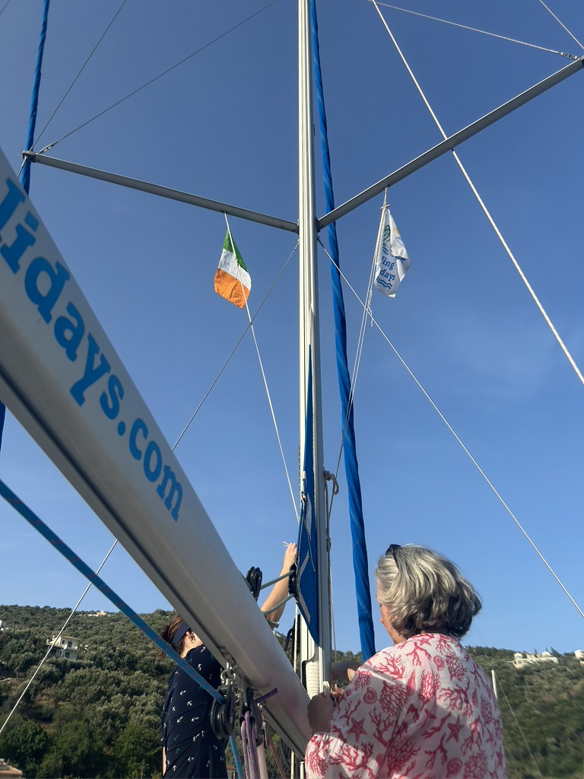
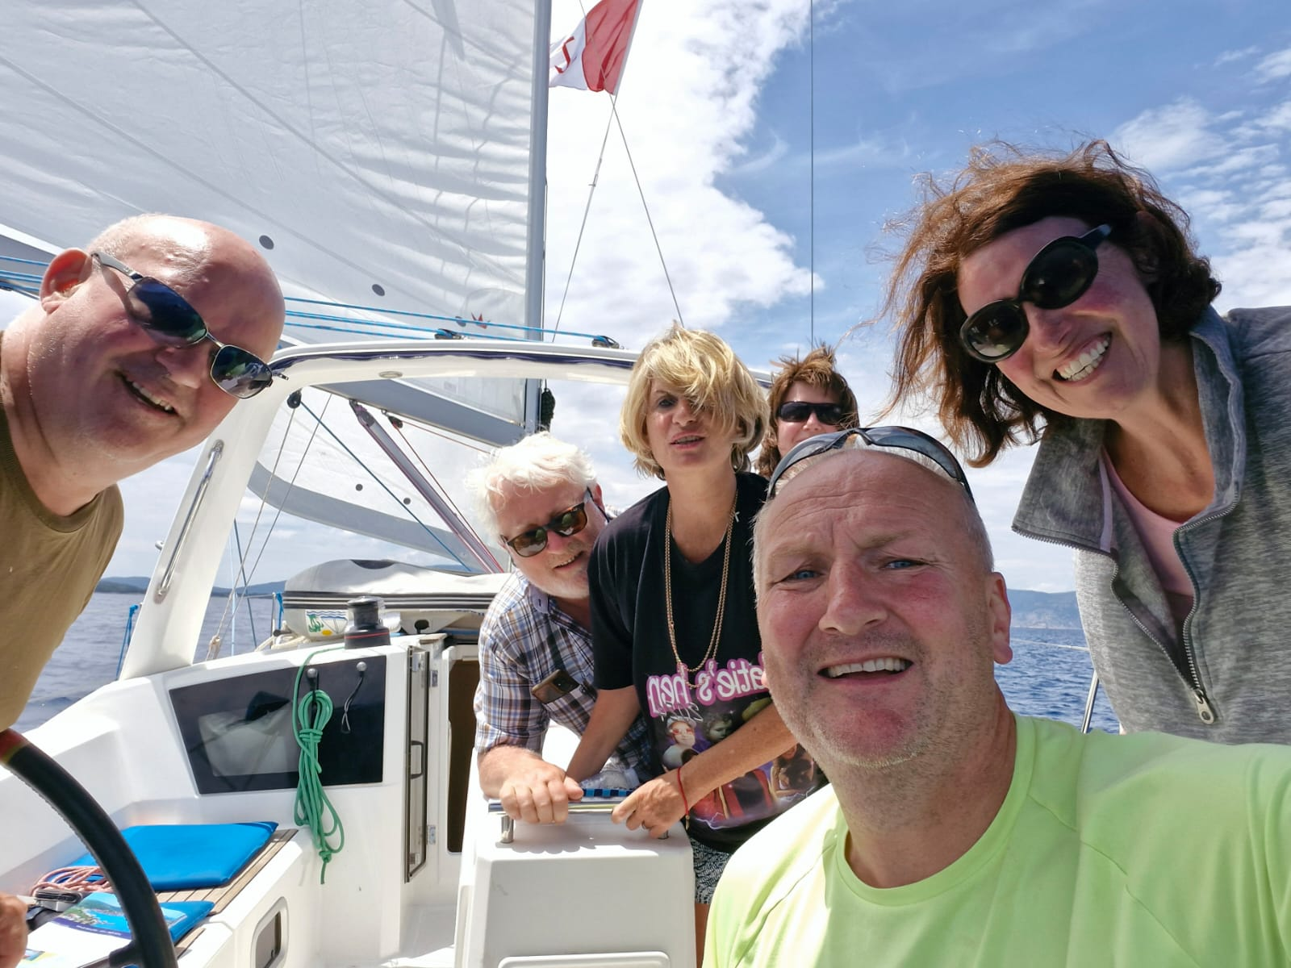
The importance of flags & burgees

Slide 9
Concerns
Preparation
Not able for the responsibility
High risk
Crew (hadn’t worked together)
Heat/ humidity
Sunburn & dehydration
What boat to choose (no clue)
What to bring/ not bring
Boat handling issues/ experience
Navigation challenges
J80s & adult dinghies
Day Skipper theory course
ICC theory & practical
Support from Carol, Sarah, Susan, Suzanne, Mark & David & Aideen many, many others…
Great MOB practice in Irl & Greece
Boat handling experiments
Competent crew
Set out/ discuss expectations
Humour

Slide 10
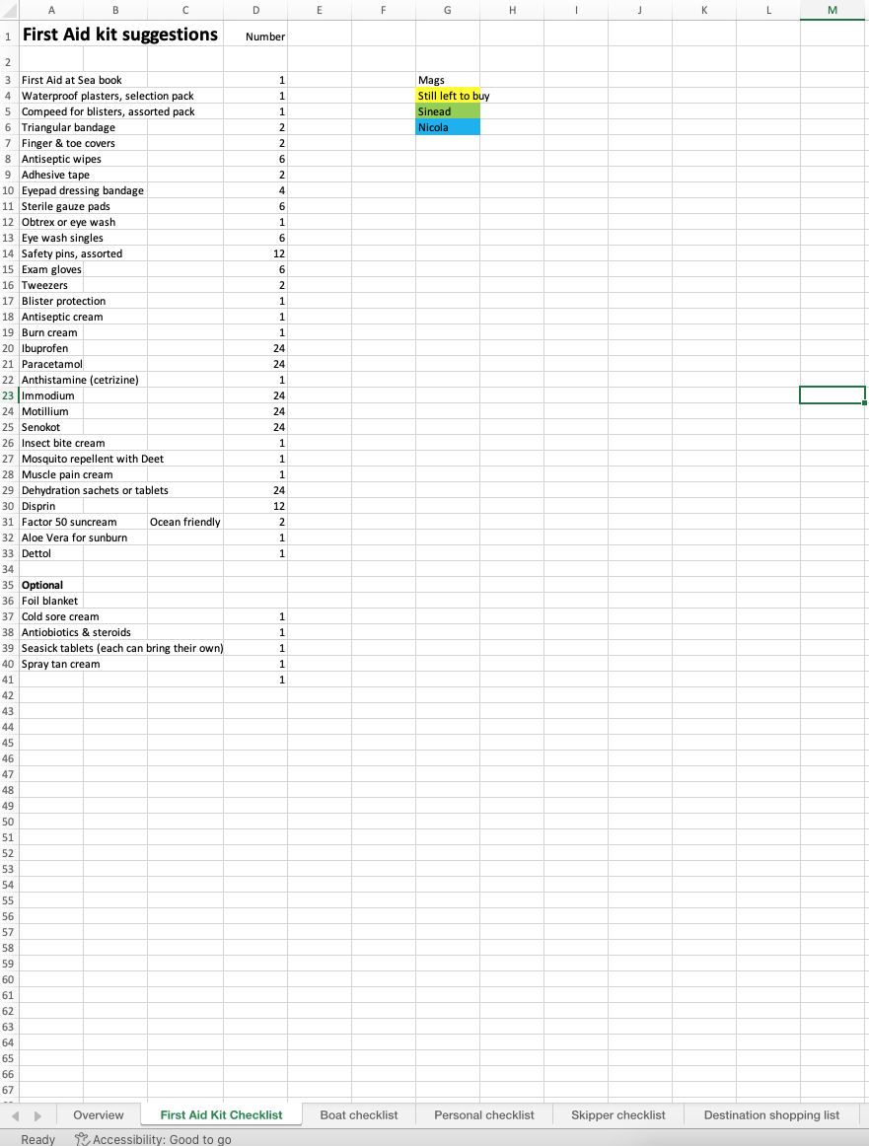
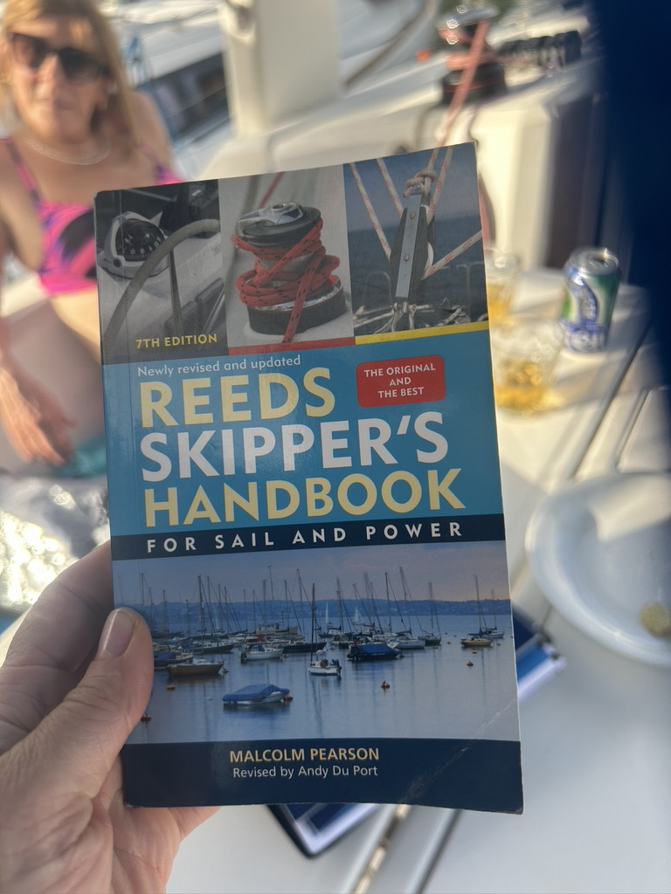
Organisation is key

Slide 11
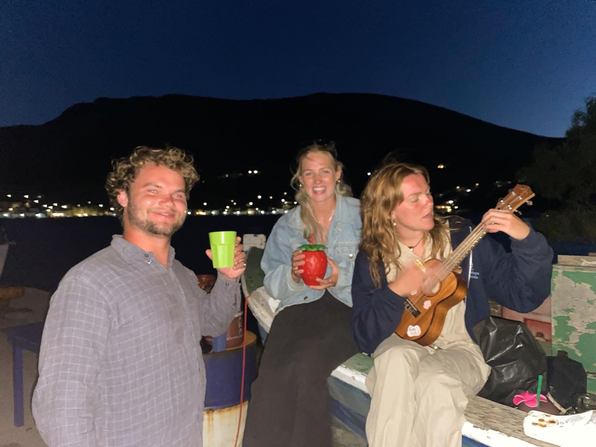
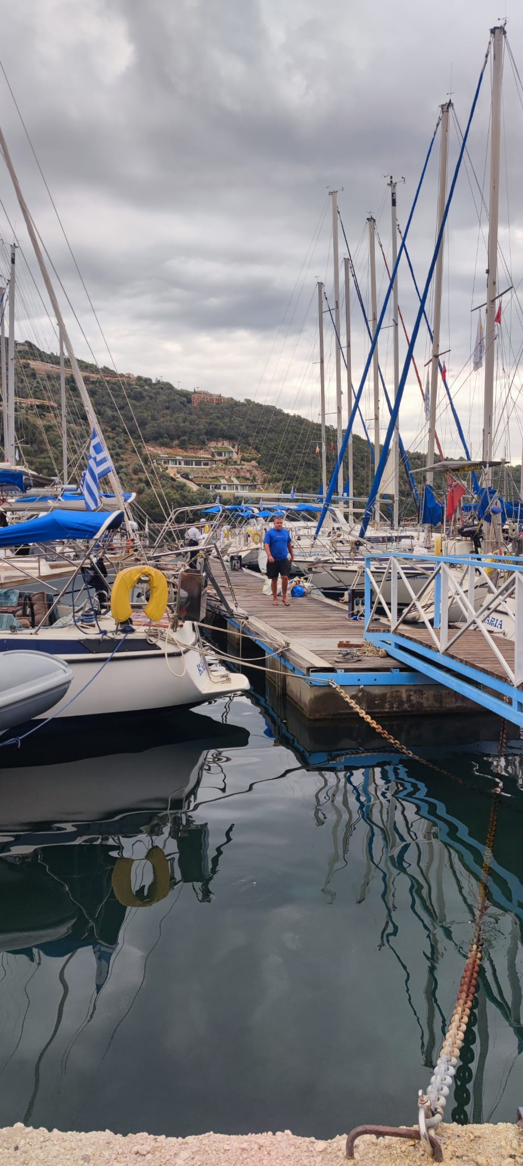
Izzy the boss (19), Trish the “hostie “ & Will the skipper for hire
Josh the engineer

Slide 12
Day One Strategy…
Get the hell away from everyone
Make mistakes in private
Practice MOB with every crew member, several times
Christen “Sean” as our troublesome MOB
Figure out what ‘Prop walk” means and how to overcome it
Most importantly: decide on soundtrack, DJ and who is in charge of the kitty.
Practice dance moves (safety first)
Check G&T and prosecco provisions

Slide 13
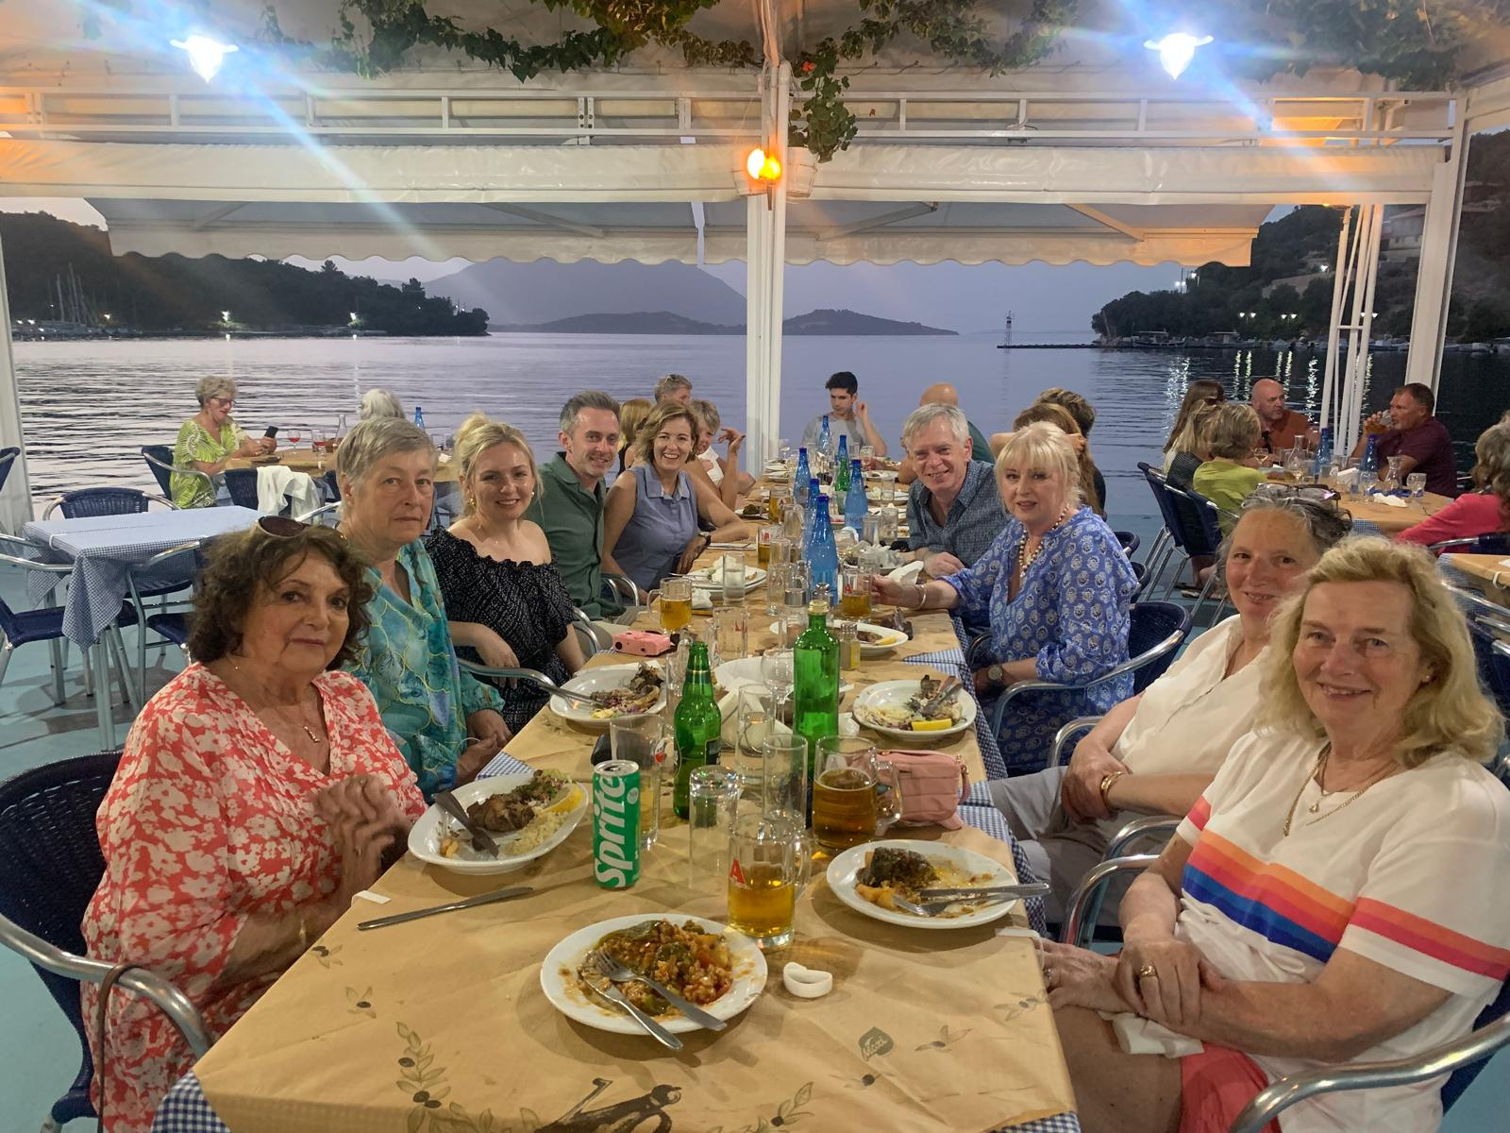

Slide 14
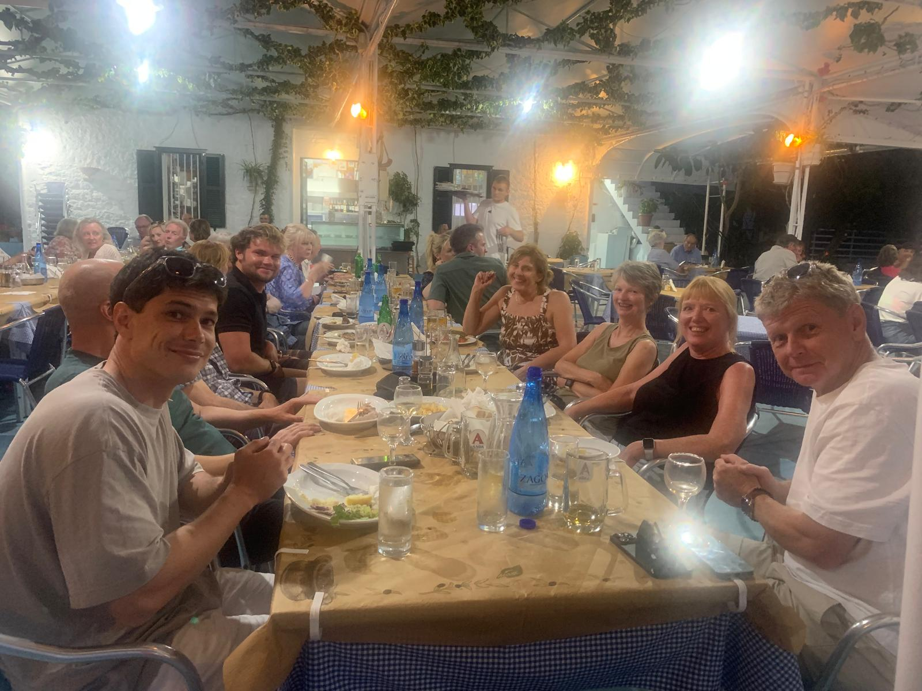

Slide 15
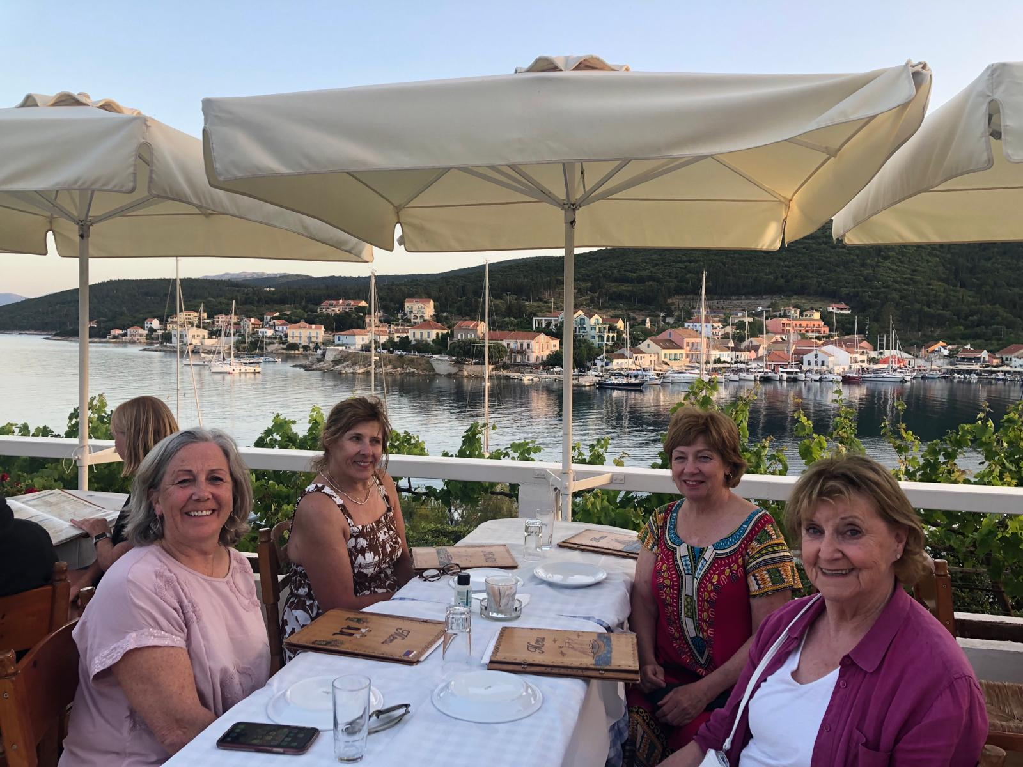

Slide 16
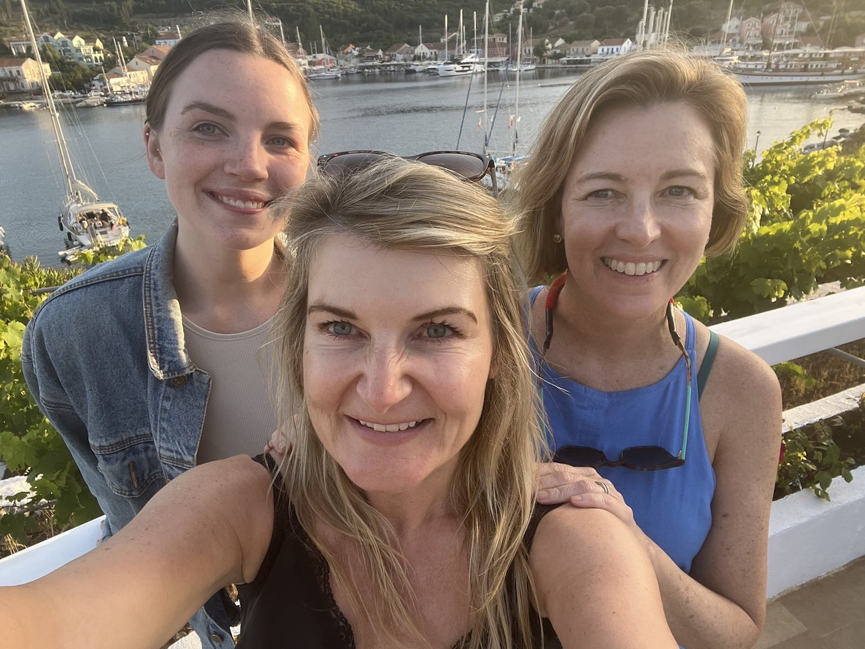

Slide 17
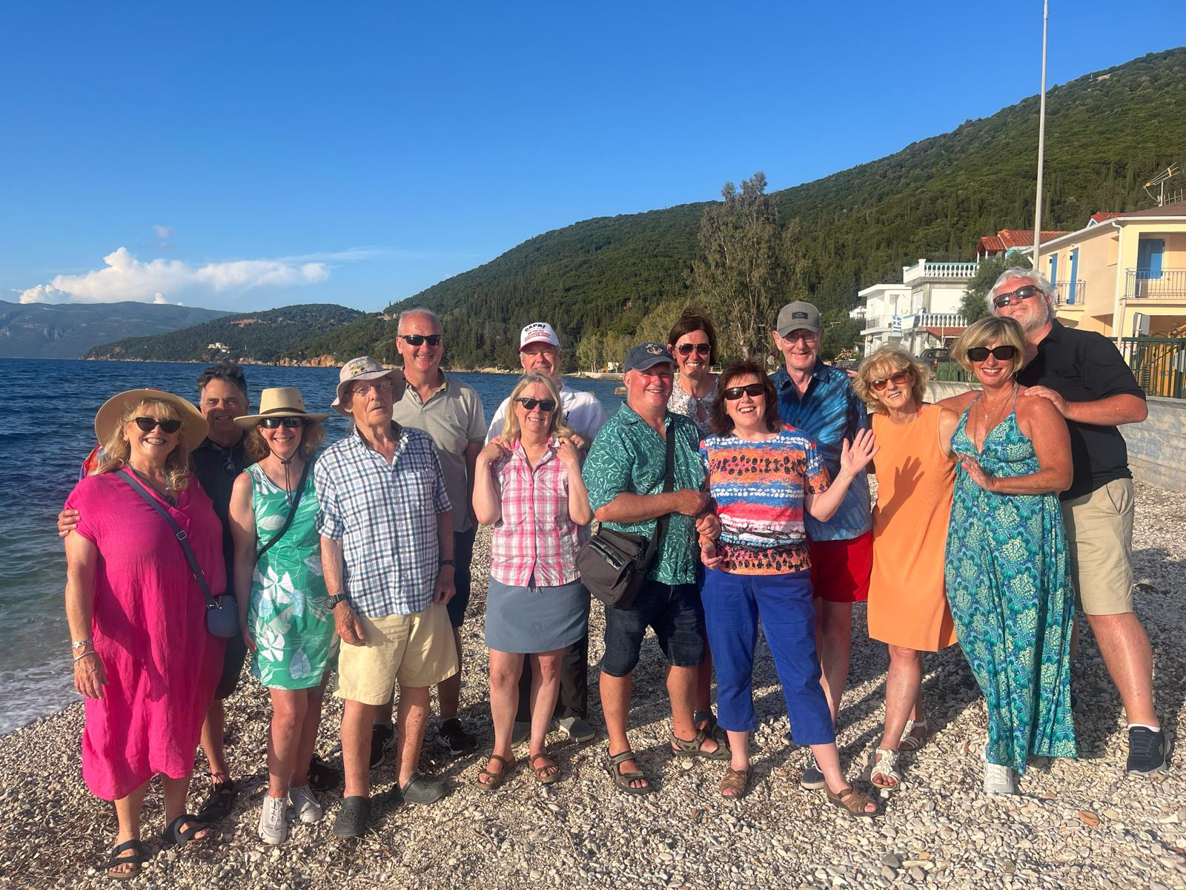

Slide 18
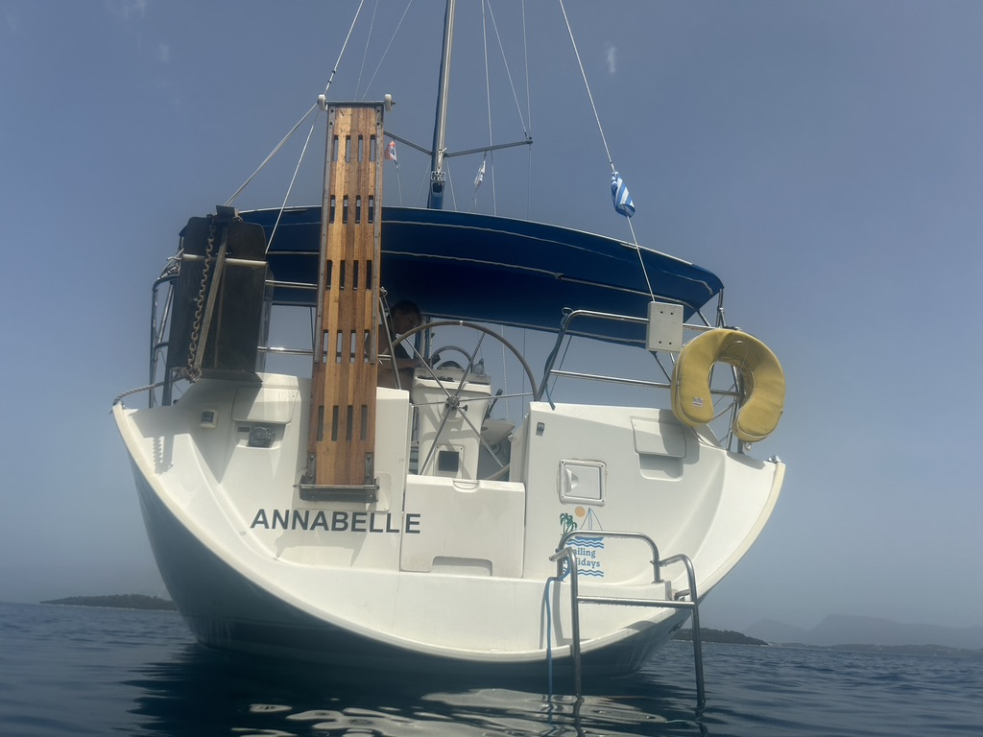

Slide 19
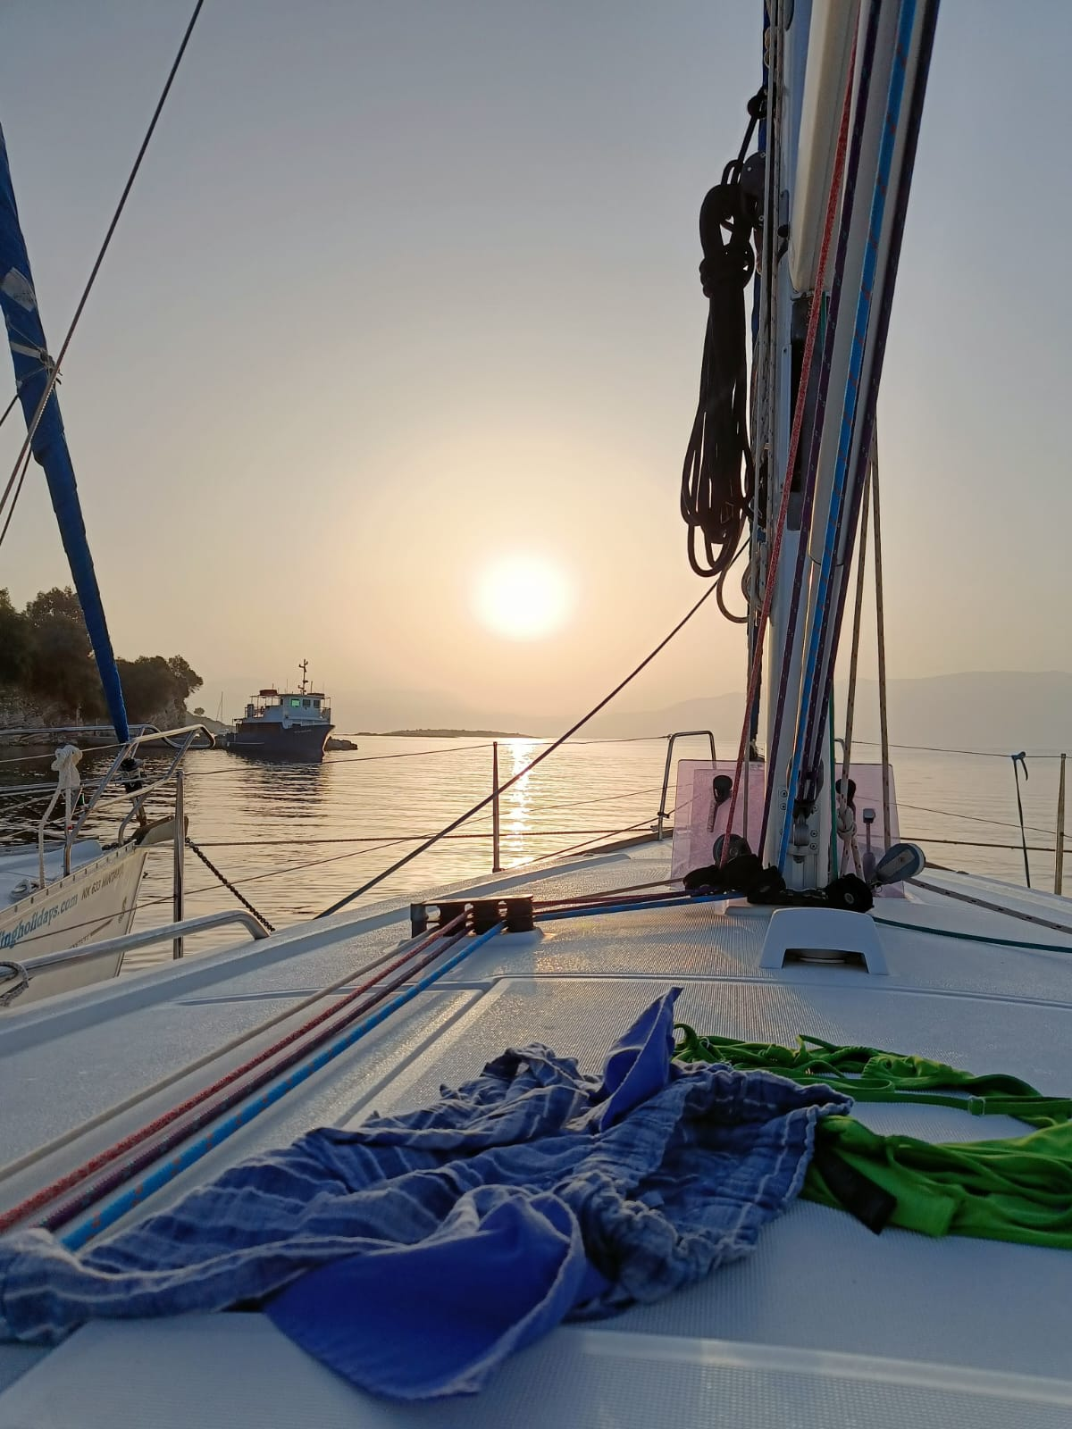

Slide 20
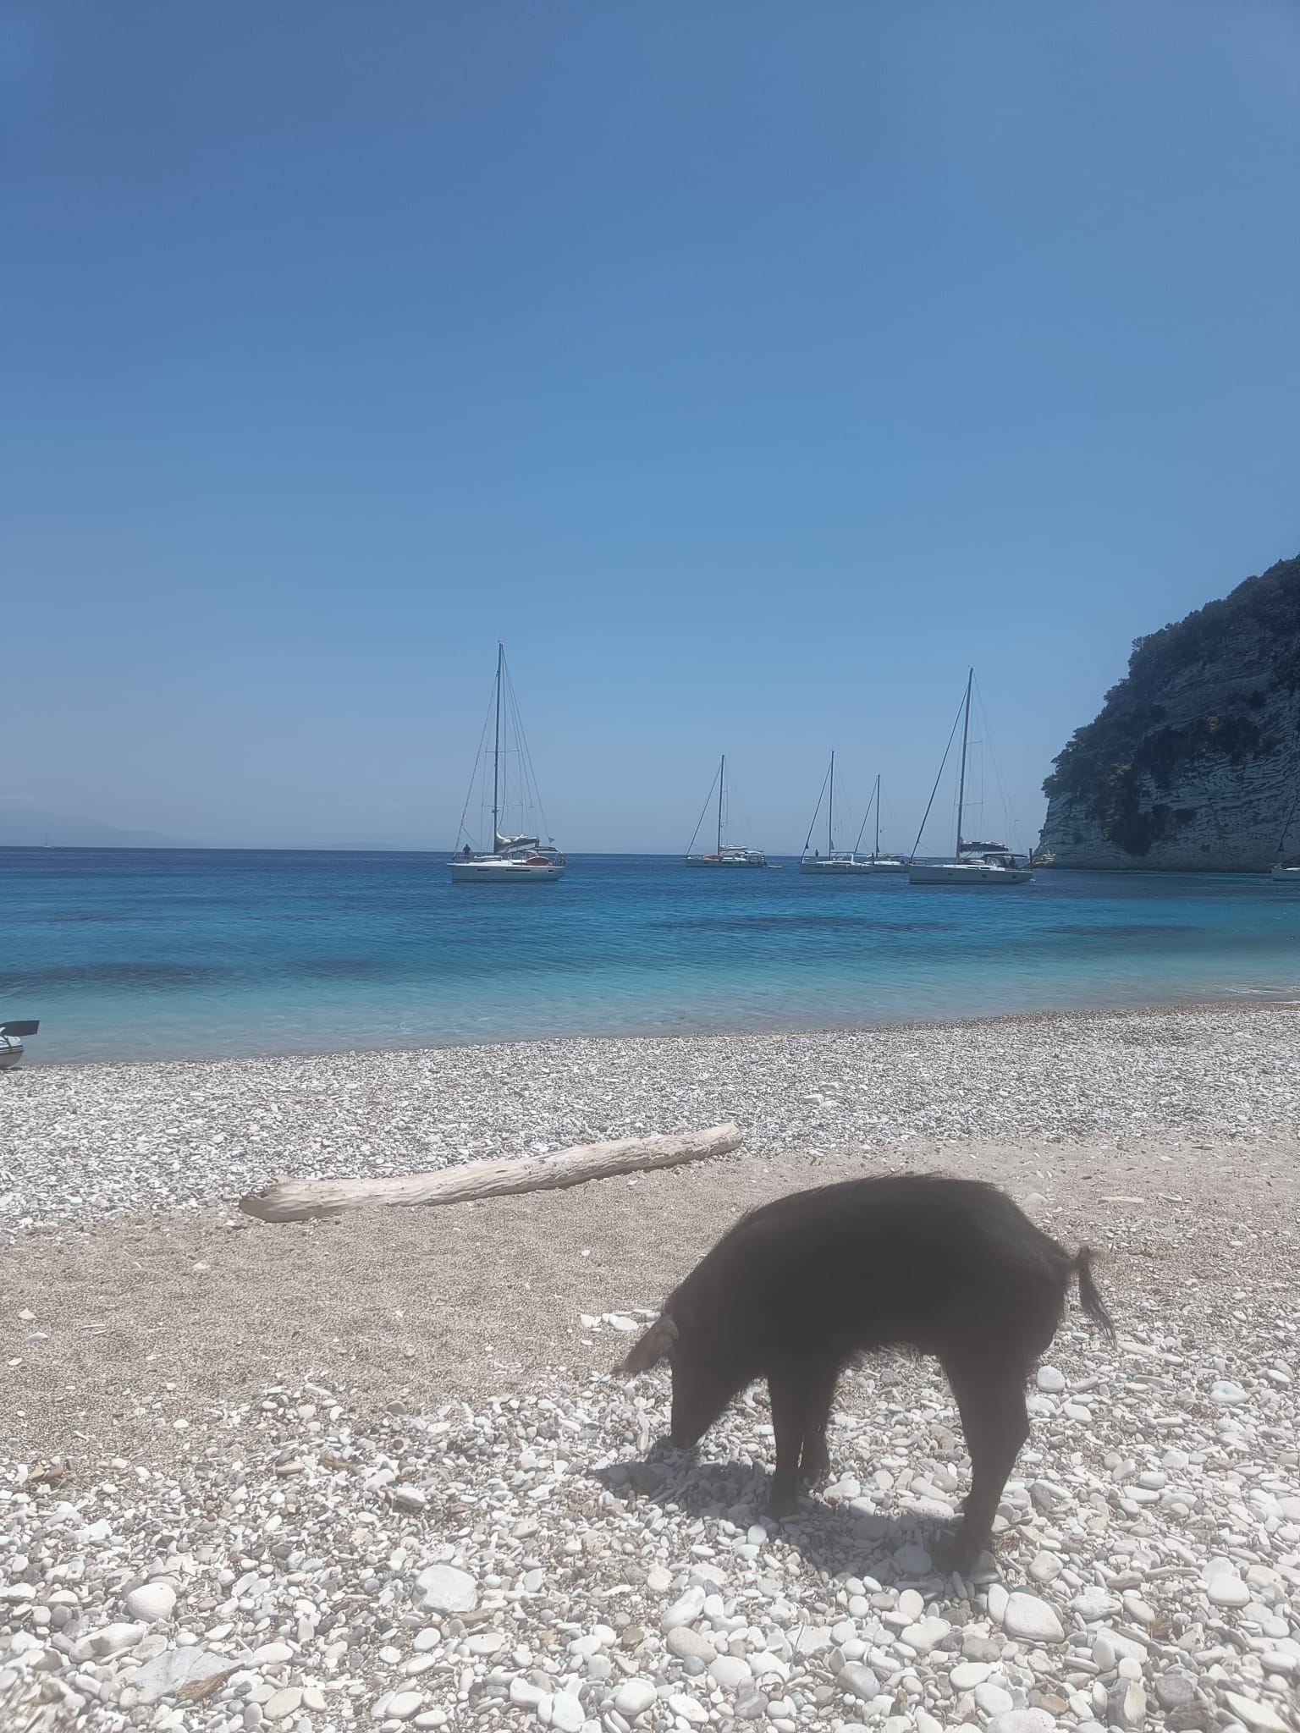
Cute little pigs or wild boars? You decide.

Slide 21
Expectations
Reality
No wind two of the days
Sad G&Ts
Showers everywhere. No loo issues. Sustainable products only
Lots of dancing, laughing, drinking & many early nights (for me)
Badly bruised crew (knees), calloused hands (me)
Anchorages, lovely swims & lunch. Regimented.
Lovely mixed group from UK
Mixed ports. Good food & shopping
Lots of help from flotilla orgs, crew & others (HYC & UK boats)
Navigation easier than anticipated (Charts only. Never used electric. Plotter, divider and later handheld compass).
HARD to moor
Sailing every day
Ice every day
Smelly head & no showers
Stressed out of my mind
Physical exhaustion
Go, go, go!!!
All HYC people
Quiet ports
Terror

Slide 22
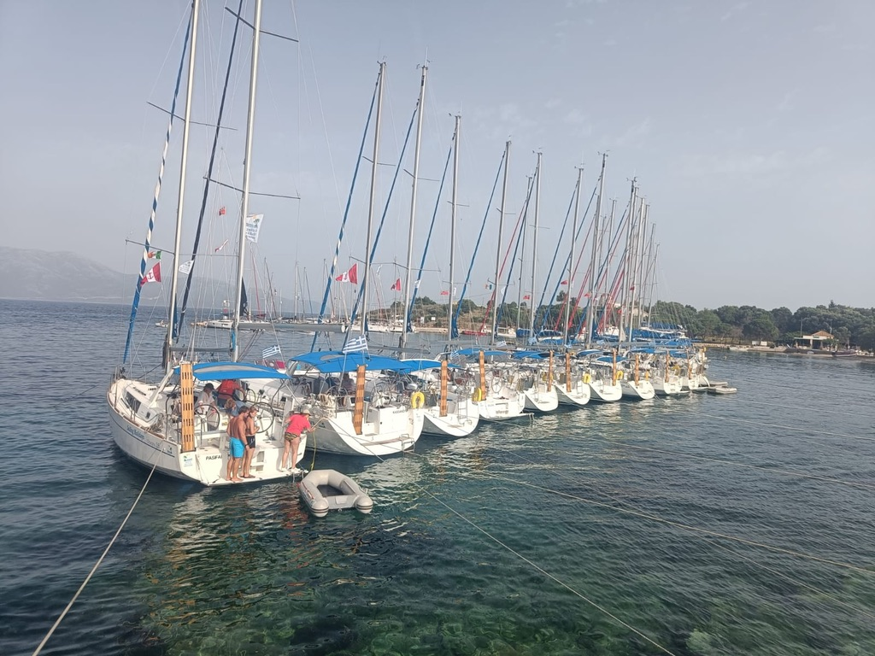

Slide 23
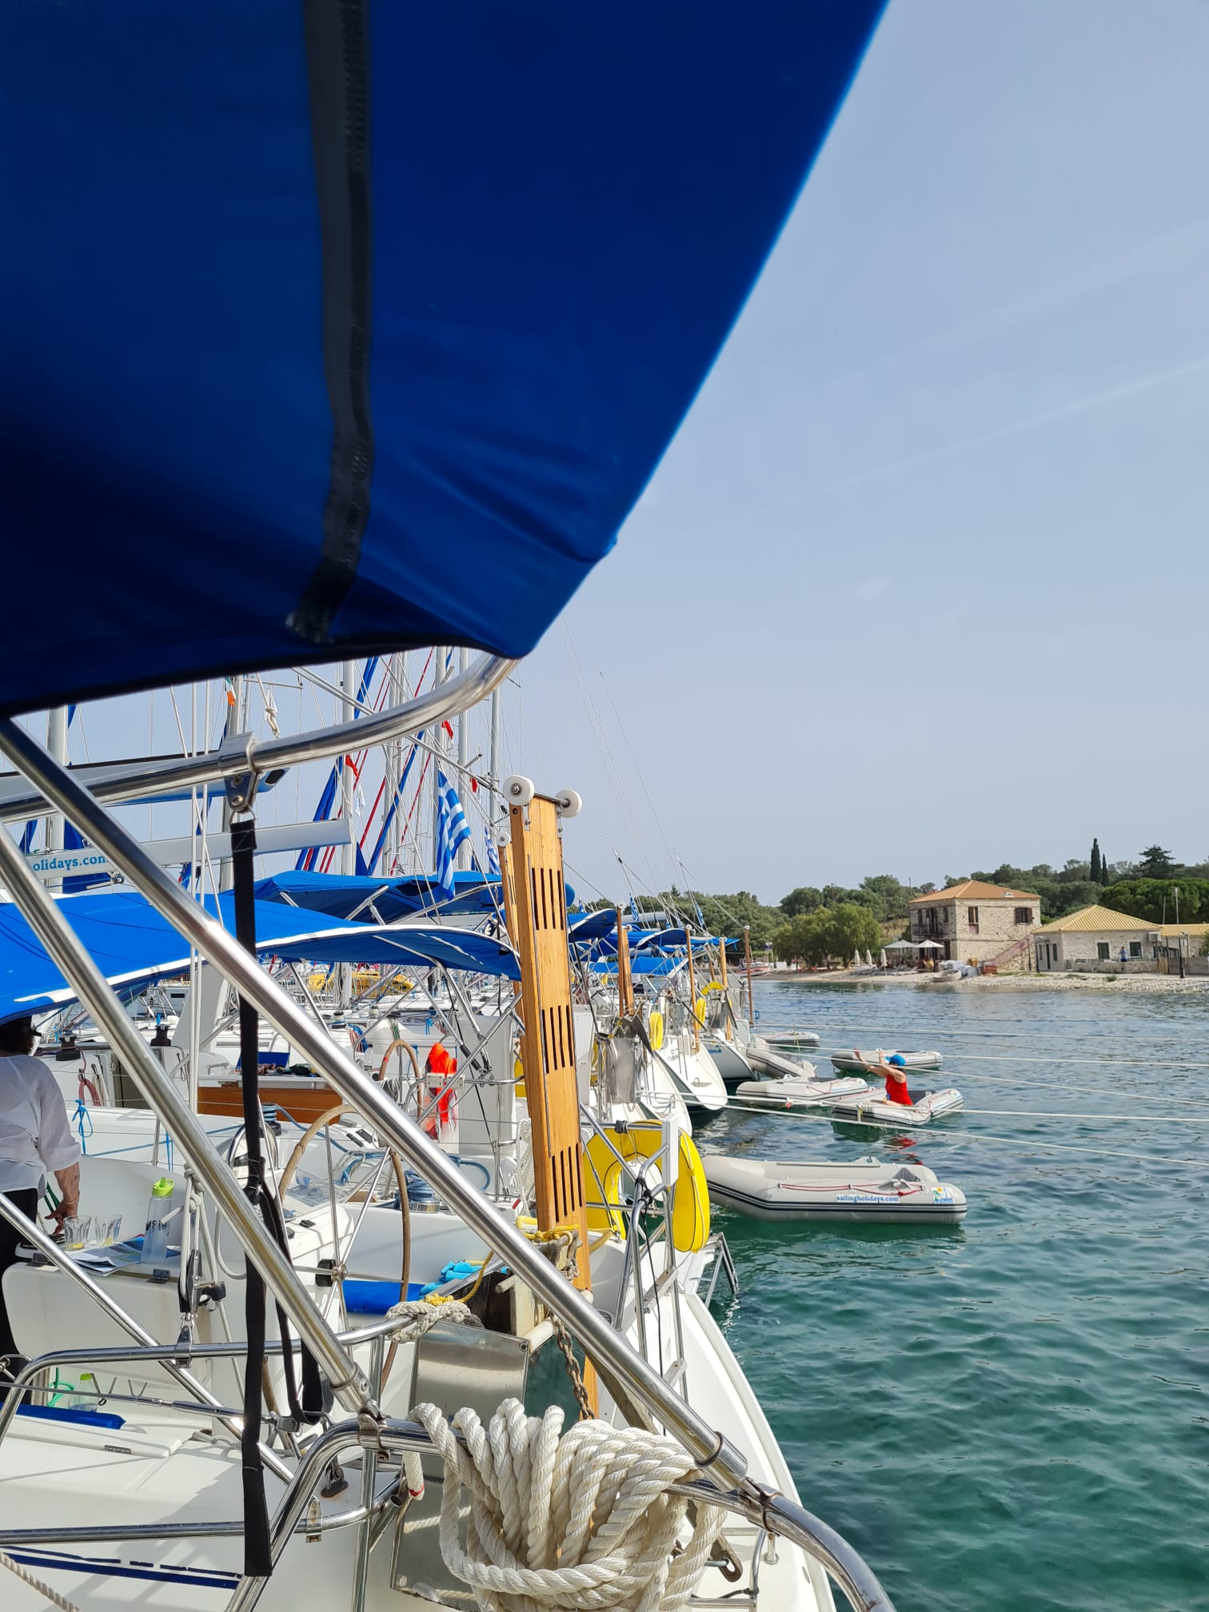

Slide 24
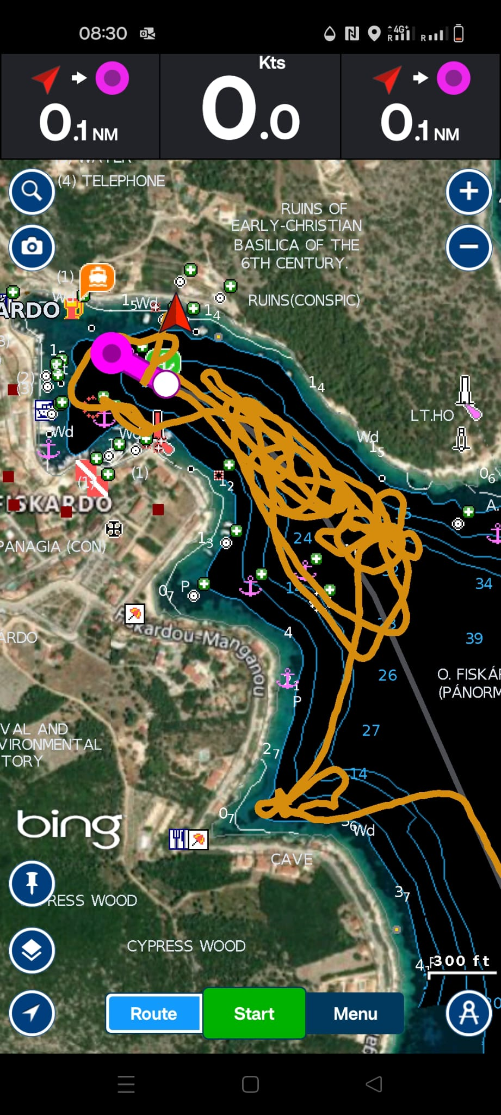
Frustrations

Slide 25
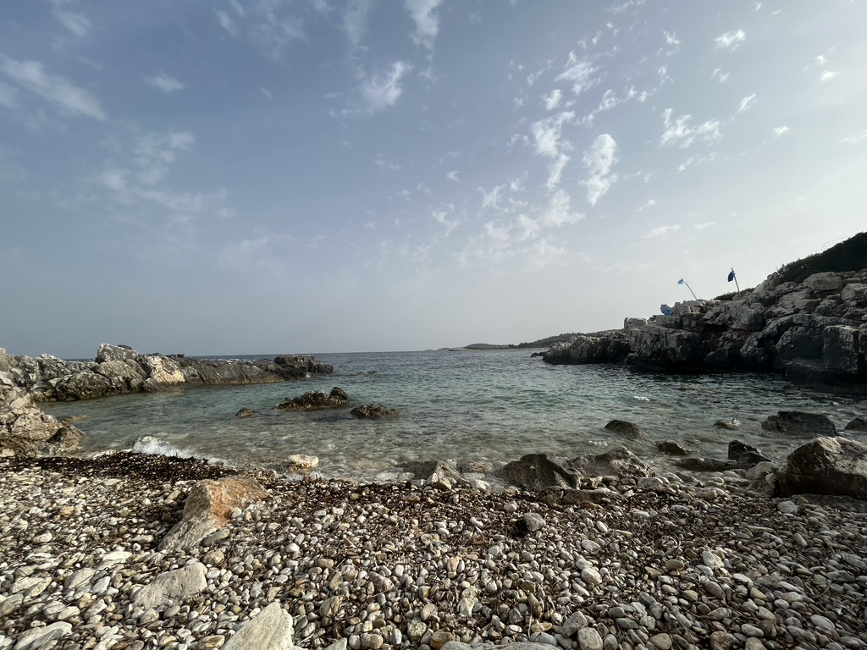

Slide 26
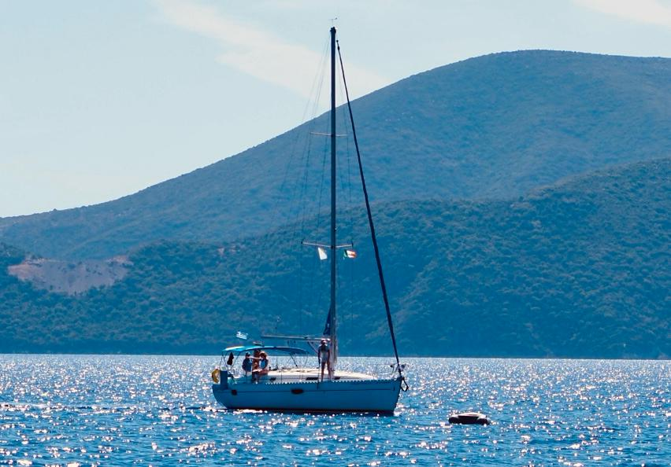
Man overboard practice pays off…lost dinghy recovery

Slide 27
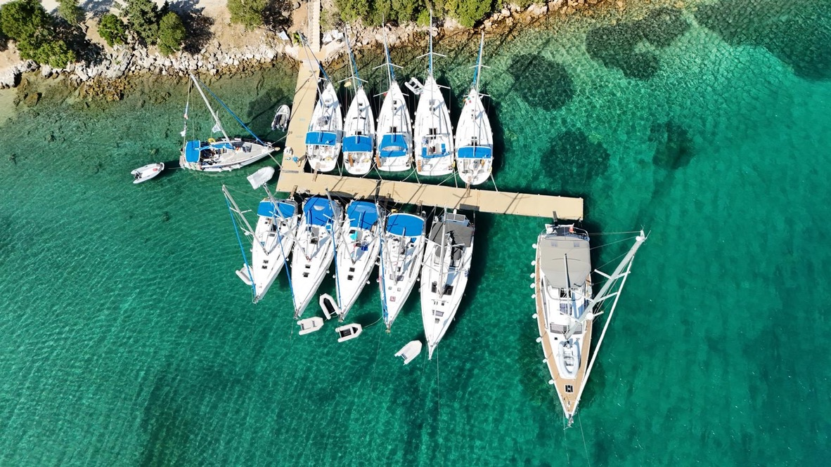

Slide 28
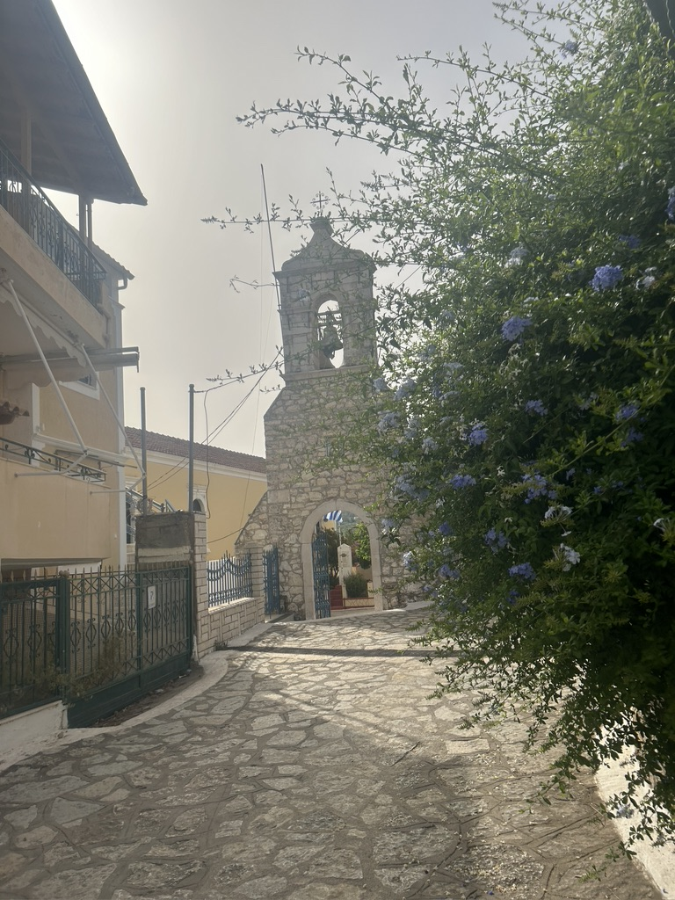
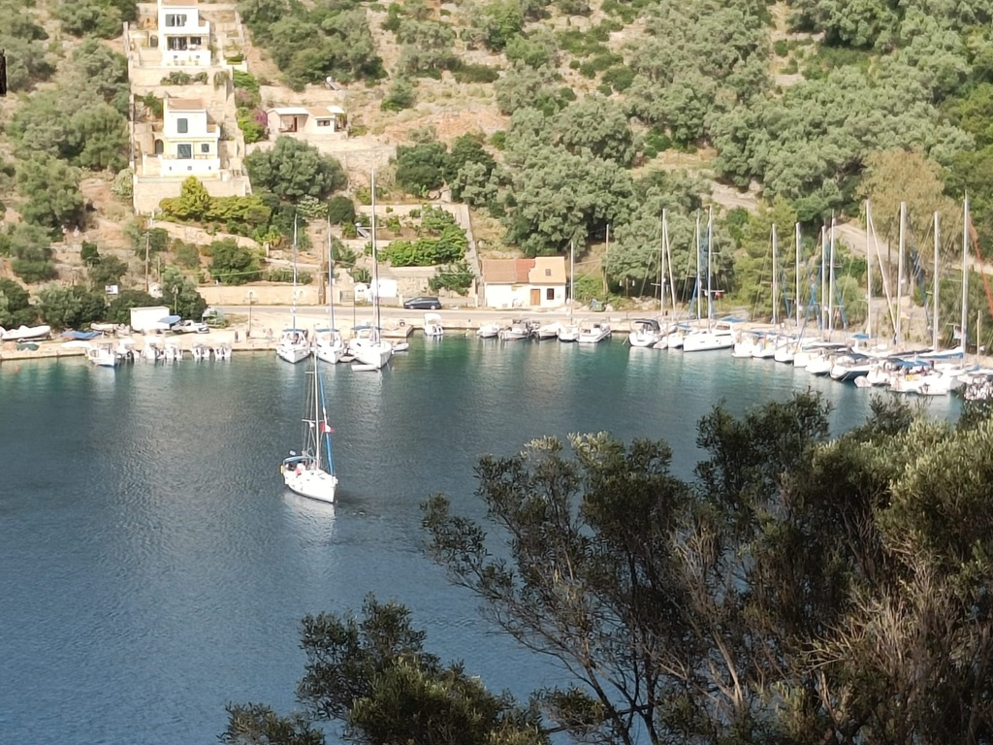

Slide 29
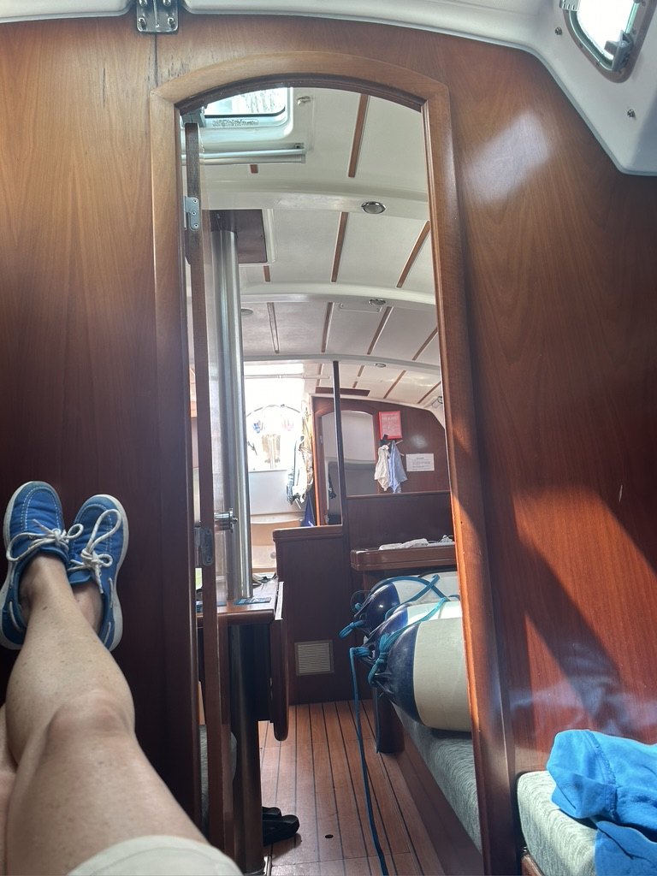
Life onboard:
Keeping it shipshape. Sustainable
Tidy
Organised
Head & shower management
Food planning
Waste management
Fuel
Water
Power/ powerbanks

Slide 30
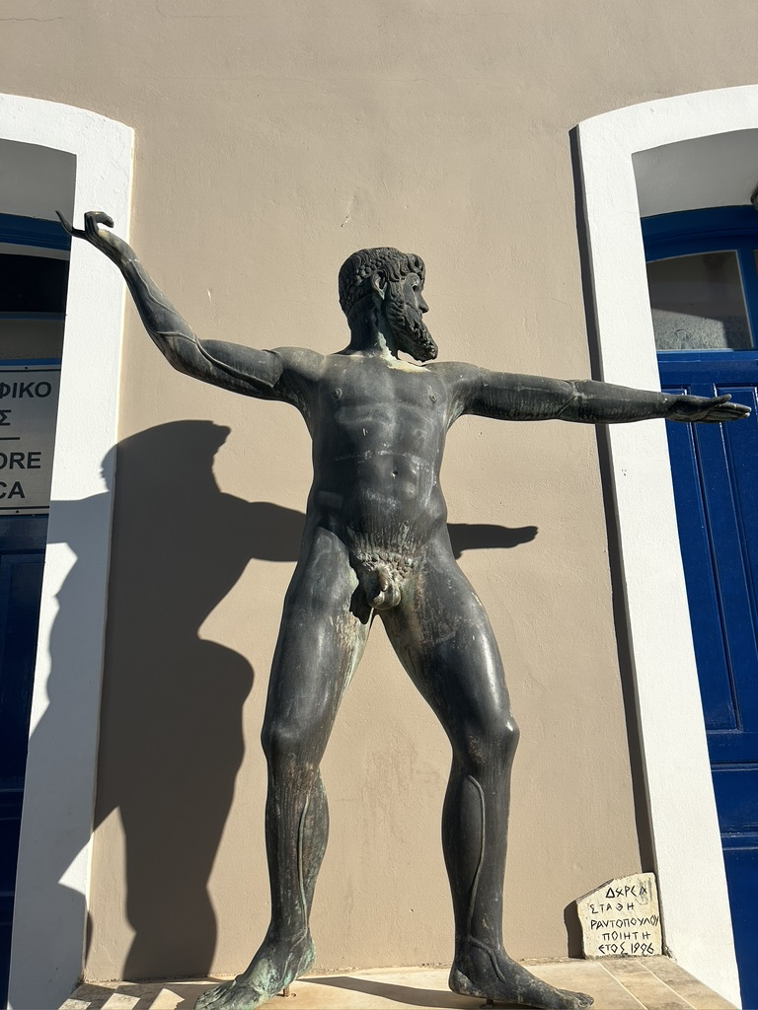
Life ashore:
Poseidon
Art
History
Ithaka
Kefalonia
Bakeries
Tavernas
Shops
Drinks
Ice
Frozen water

Slide 31
Punch party (not bareknuckle fighting)
* Love blossomed. Jobs secured.

Slide 32
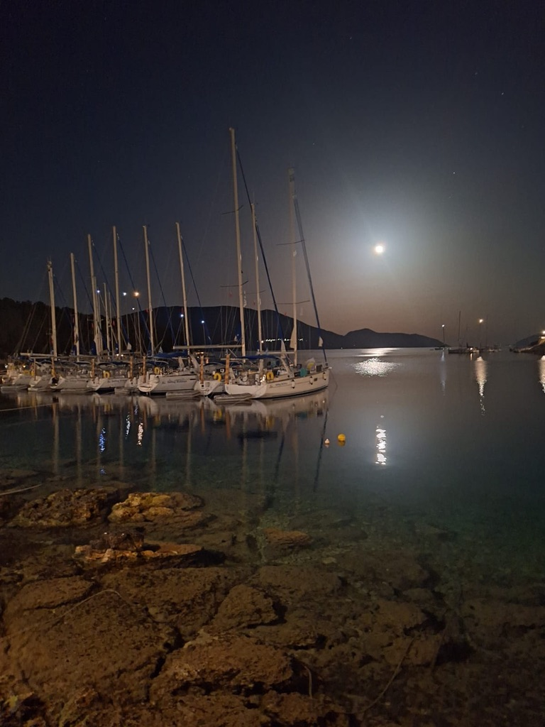

Slide 33
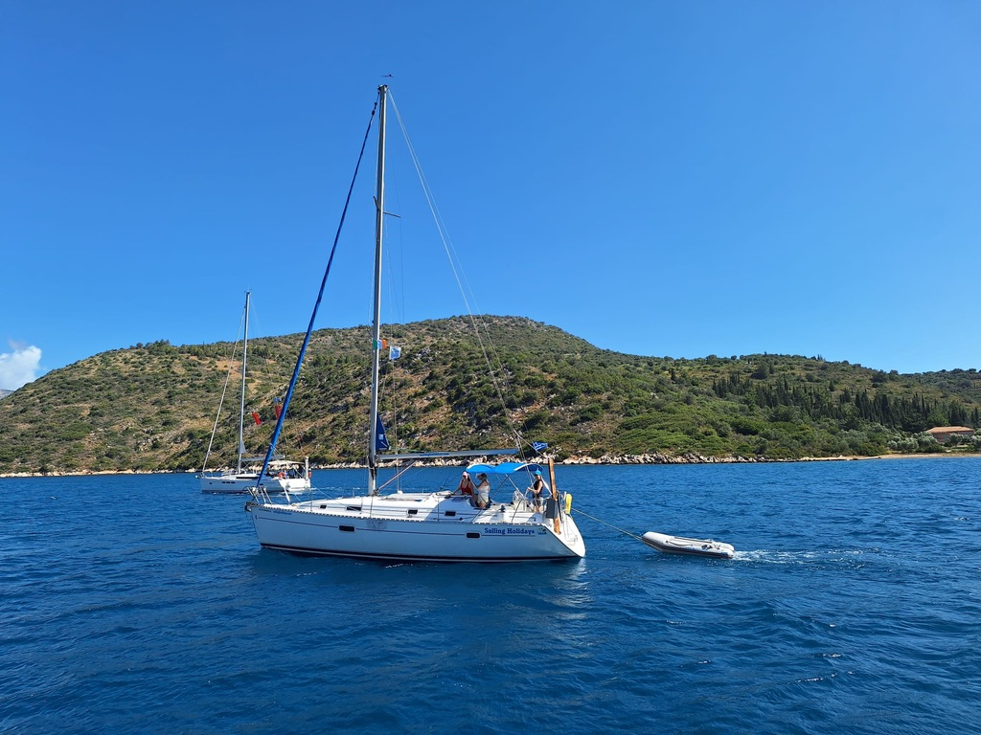
Dancing has consequences….

Slide 34
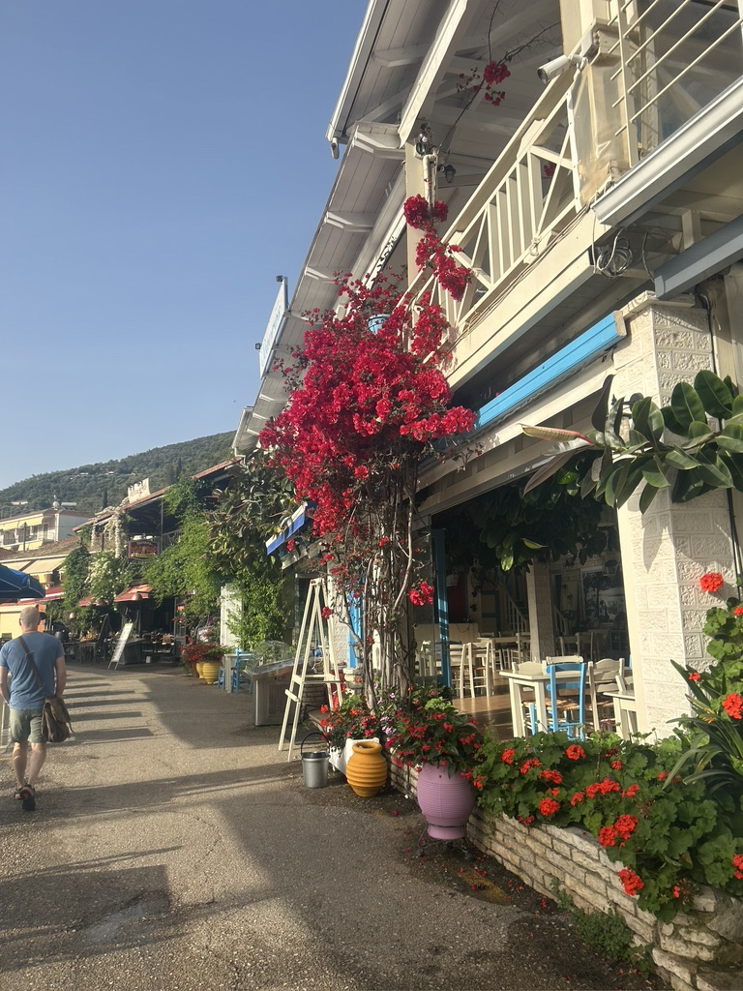
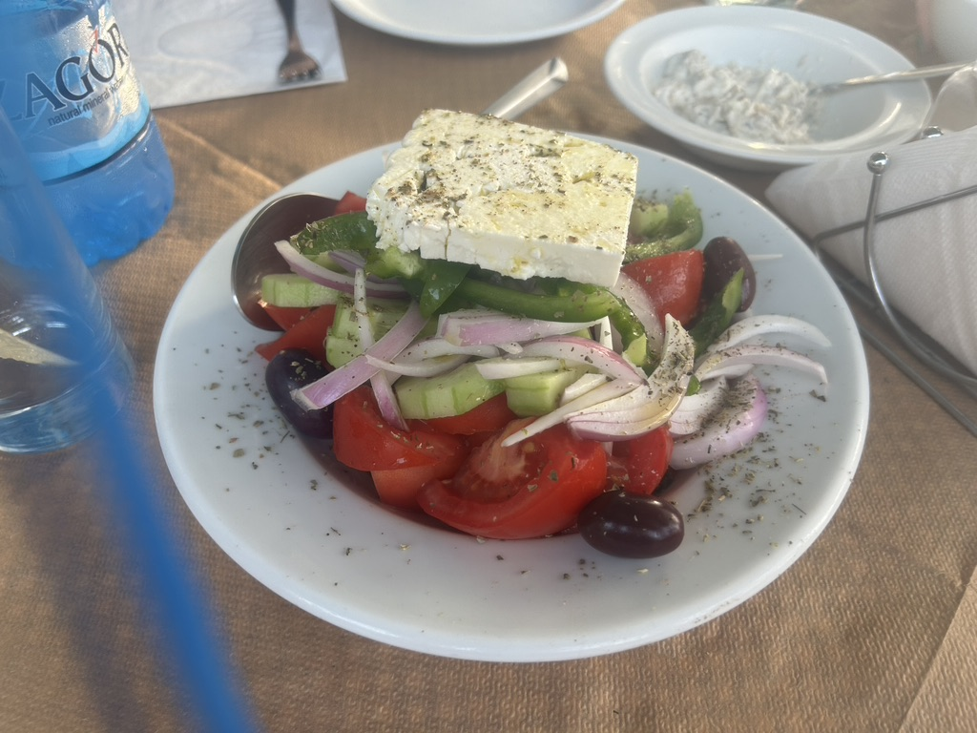

Slide 35
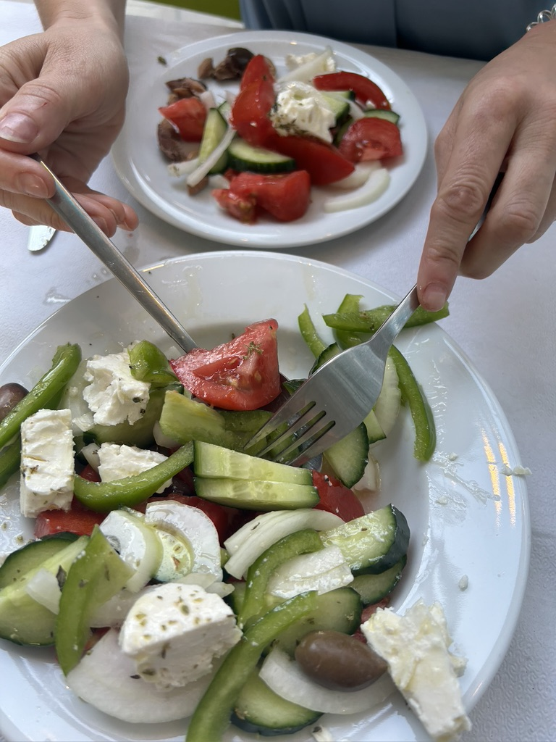
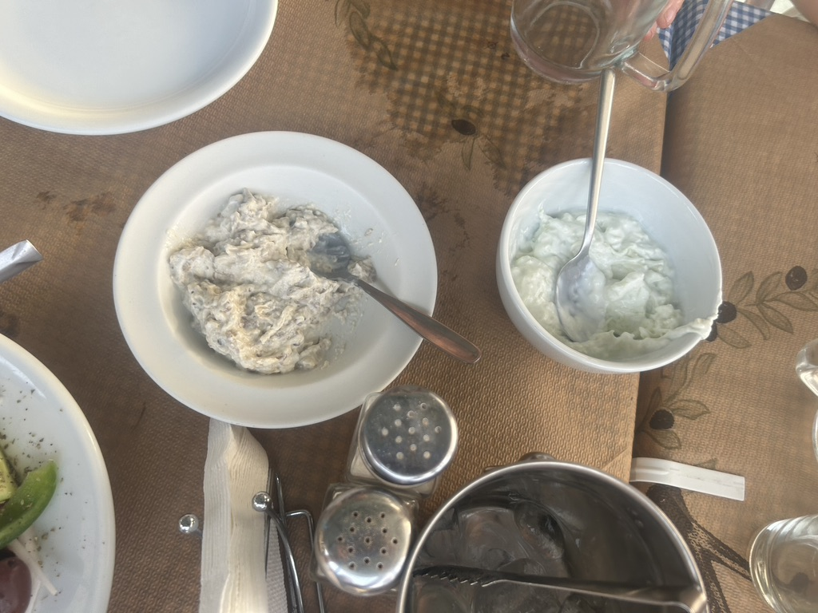

Slide 36
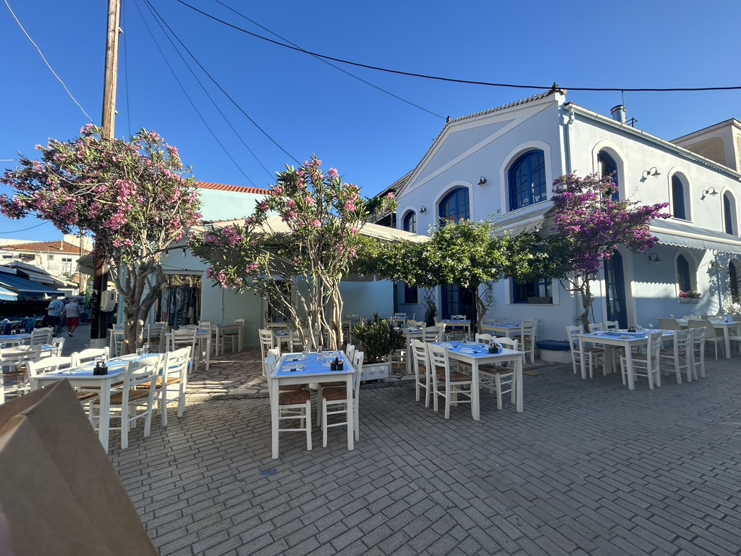

Slide 37
Mystery to solve:

Slide 38
Mystery to solve:

